Slide 1
LHS Band Booster Meeting Tuesday, July 19th, 2022

Slide 2
Agenda
Welcome
Football Season Tickets- Owen Prince
Getting Involved
Fundraising Opportunities
Important Fall Dates
Band Store
San Antonio Trip- Volunteers
Next Band Booster Meeting
Chaperone, Nurse, Bus Driver, P&P Meeting

Slide 3
Important Fall Dates- Mr. Bowman
Picture Day- This Friday, July 22nd
Band Camp (week 1 and week 2)
End of Camp Band Dance- Friday, July 29th
1st Day of School- Friday, August 5th
After School Practices
Football Games
Super Saturday Practice- Saturday, September 17th
Contest- Saturday, September 24th
Contest- Saturday, October 1st
Battle on the Border- Saturday, October 22nd
Playoff Games
Parades

Slide 4
2022 Booster Officer’s
President- Chris Buescher
Vice-President- Michael Spence
Secretary- Suzanne Tanner
Treasurer- Kevin Hiers
Student Accounts Treasurer- Jocelyn Norman
Member-at-Large- Leslie Kautzman

Slide 5
Getting Involved
There are lots of ways to get involved with the Bridgemen
We WANT parents involved (must complete background check)
Areas to serve-
Water
Nurse
Bus Driver
Prop & Pit
Chaperone (Home and Travel)
Uniforms

Slide 6
Getting Involved
We will have a meeting for all volunteers that attended the Background Check meeting in June on Tuesday, August 9th at 6:00 pm.
If you would still like to get involved, please see Leslie Kautzman tonight to complete your Background Check

Slide 7
Uniforms
Tamara Oglesby

Slide 8
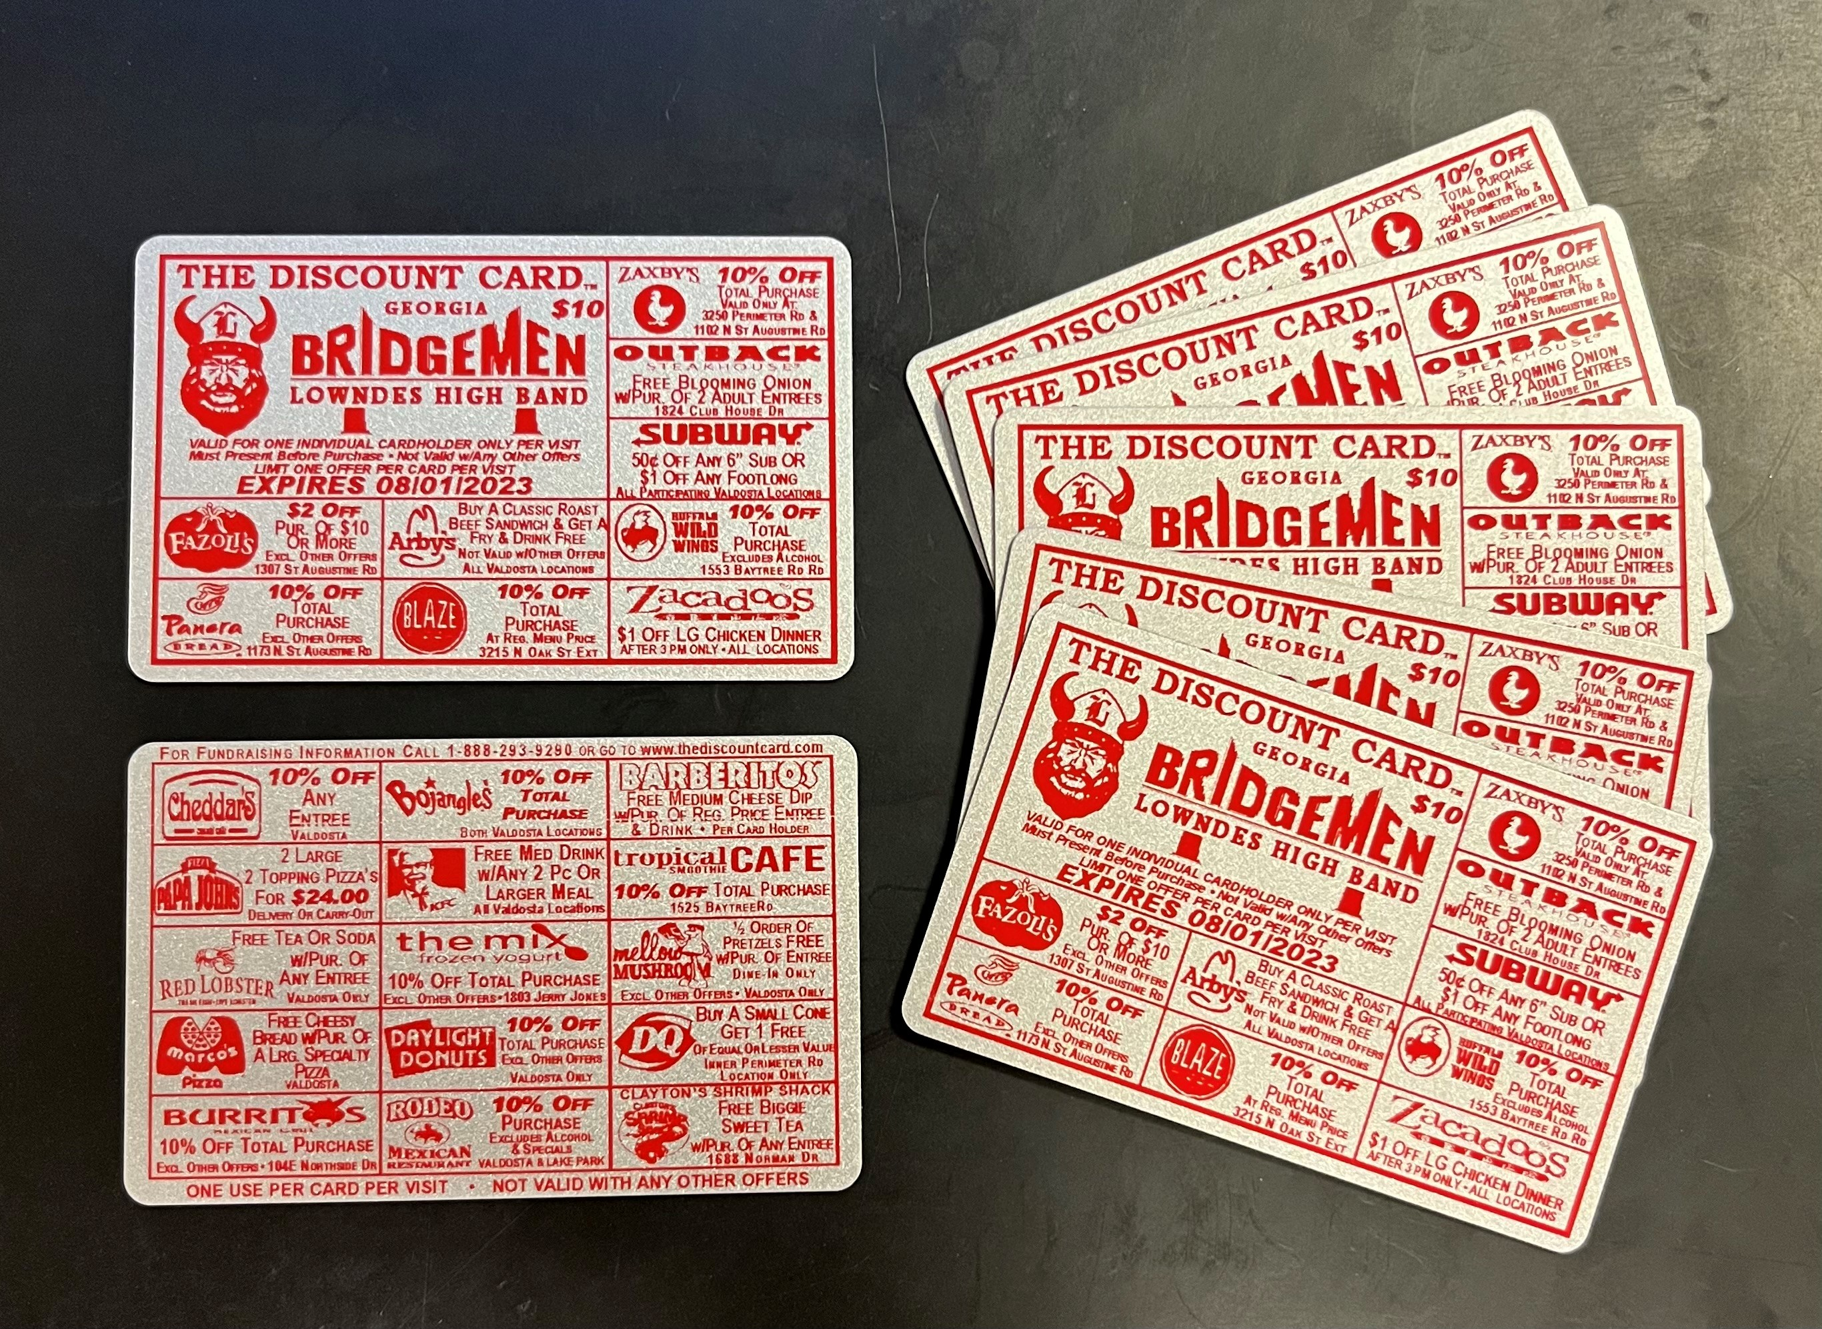
Fundraising Opportunites
Discount Cards-

Slide 9
Football Program and Senior Ads
Football Program ad sales- credits will be applied at the end of August
Senior Ads- it’s not to late to celebrate your Senior. Ads are $90, Please complete the Senior Ad Form found on georgiabridgemen.org

Slide 10
IMPORTANT FALL DATES
Cleanup Day- THANK YOU to all of the volunteers that helped us get ready for camp!!!
Picture Day- Friday, July 22nd
Talent Show/Band Dance- Friday evening, July 29th
Future Bridgemen Camp (Auxiliary)- Saturday, August 6th

Slide 11
Important Fall Dates continued
South Georgia Football Classic- Saturday, August 20th (Martin Stadium)

Slide 12
Band Store
Sale
New Merchandise
Cookbooks
Chaperone Shirts
Open next week from 3 pm- 8 pm

Slide 13
San Antonio Trip- Parent Volunteers
Dual Occupancy- $920/person
Quad Occupancy- $720/person
Enhanced Background Check for overnight trips- $55/person
All trip payments go through Group Travel

Slide 14
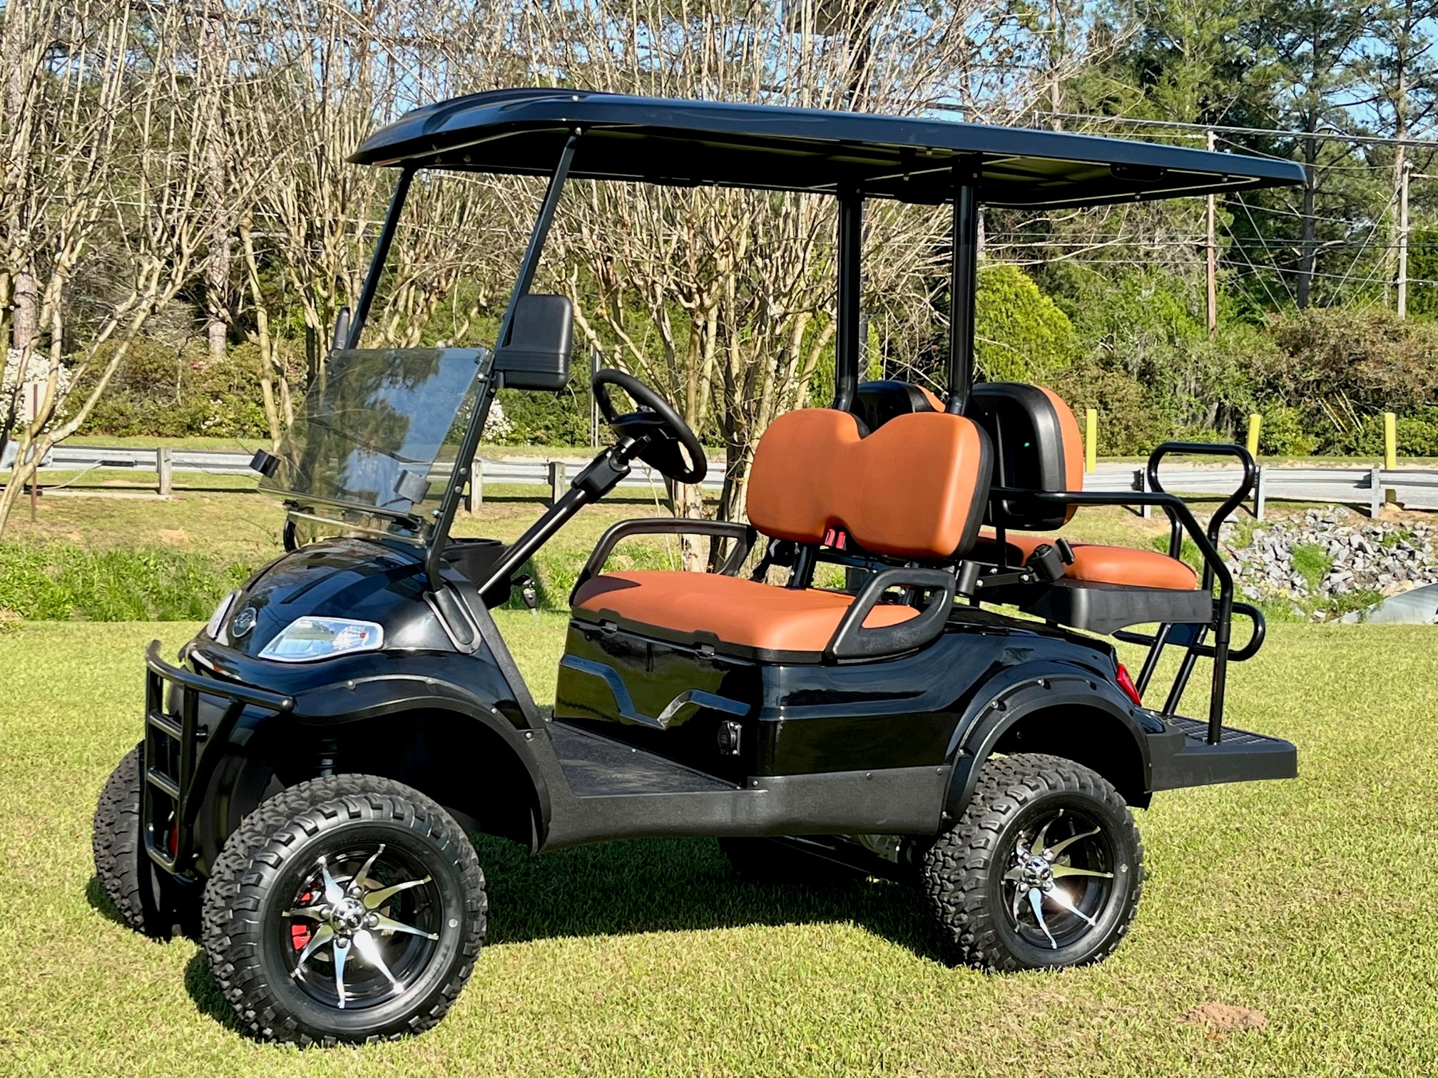
Electric Vehicle Raffle
Our annual Golf Cart Raffle (now an Advanced EV for 2022) tickets are on sale. Please see Suzanne Tanner tonight for your chance to win. Tickets are only $5 each and the drawing will be held on Friday, October 28th. The value of this Advanced EV is $9,995!

Slide 15
Stay Informed
Ways to stay informed
Facebook- Lowndes High Georgia Bridgemen
Facebook Photos- Lowndes High Georgia Bridgemen Photos Page
Facebook Band Store- Lowndes High Georgia Bridgemen Band Store
App- Band- App for all groups… Lowndes High Georgia Bridgemen

Slide 16
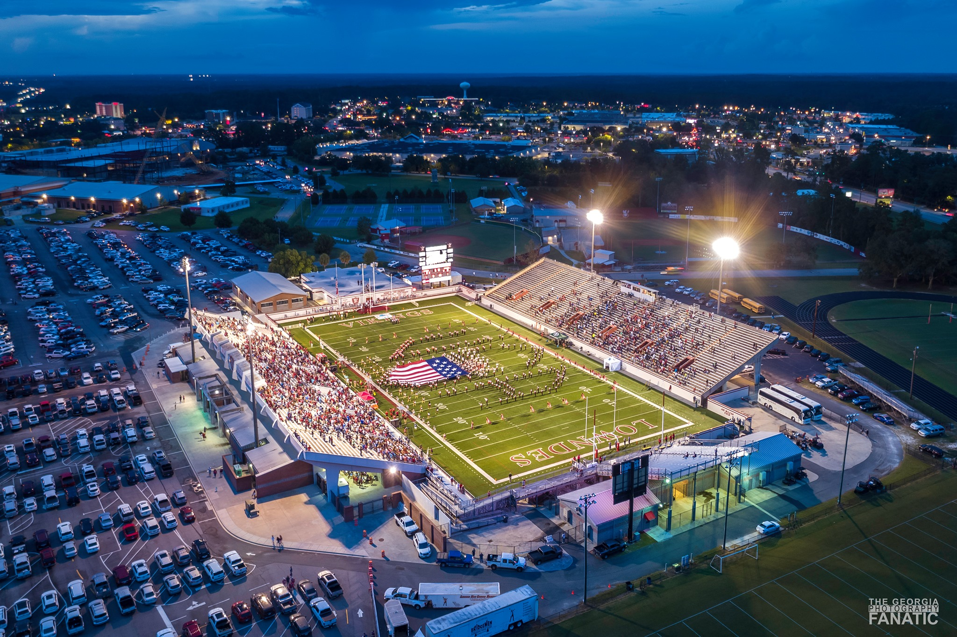
Questions

Slide 17
Volunteer ONLY Meeting
VOLUNTEER ONLY MEETING
Tuesday, August 9th @ 6:00 PM Band Room

Slide 18
Next Booster Meeting Tuesday, August 23rd @ 6:00 PM Cafeteria

