Slide 1
LHS Band Booster Meeting Thursday, October 28th, 2021

Slide 2
Agenda
Welcome
Important Fall Dates
Battle on the Border
Officer Nominations
Reverse Draw
Special Treat

Slide 3
Important Fall Dates
Away Game vs Camden Co- Friday, Oct 29th
Fall Band Trip (Orlando) - November 4th- 7th
1st Round of Playoffs- Friday, November 12th
Reverse Draw- Saturday, November 13th
2nd Round of Playoffs- Friday, November 19th
3rd Round of Playoffs- Friday, November 26th
4th Round of Playoffs- Friday, December 4th
Valdosta Christmas Parade- Saturday, December 5th
Senior Banquet- Tuesday, December 7th
State Championship Game or Christmas Parade- Saturday, December 11th

Slide 4
Battle on the Border recap
THANK YOU to our volunteers and those that loaned us equipment to use!!!
Despite it being 3 years since we last hosted BOB due to weather and a pandemic…
Our 2021 event was the MOST SUCCESFULL B.O.B. EVER
THANK YOU TO EVERYONE INVOLVED!!!

Slide 5
Officer Nominations
Officer Nominations for 2022 elected positions are now closed
President- Chris Buescher
Vice-President- Michael Spence
Secretary- Suzanne Tanner
With the election being uncontested, the current officers are deemed re-elected

Slide 6
Reverse Draw- Saturday, November 13th
Our 4th Annual Reverse Draw is Saturday, November 13th at the Elk’s Lodge. Tickets are $100 each and it gets you and a guest in for heavy hors d'oeuvres and a chance to WIN $10,000!
You do not have to be present to win
Only 300 tickets being sold
Proceeds benefit the Bridgemen
We need help selling tickets

Slide 7
Special Treat
We have Russell and Brenda here from Kona ice and they want to treat the band members in attendance to a FREE Kona ice
Additionally, they are willing to donate 100% of any non-member purchases made tonight to the Bridgemen to go towards the cost of our Orlando trip

Slide 8
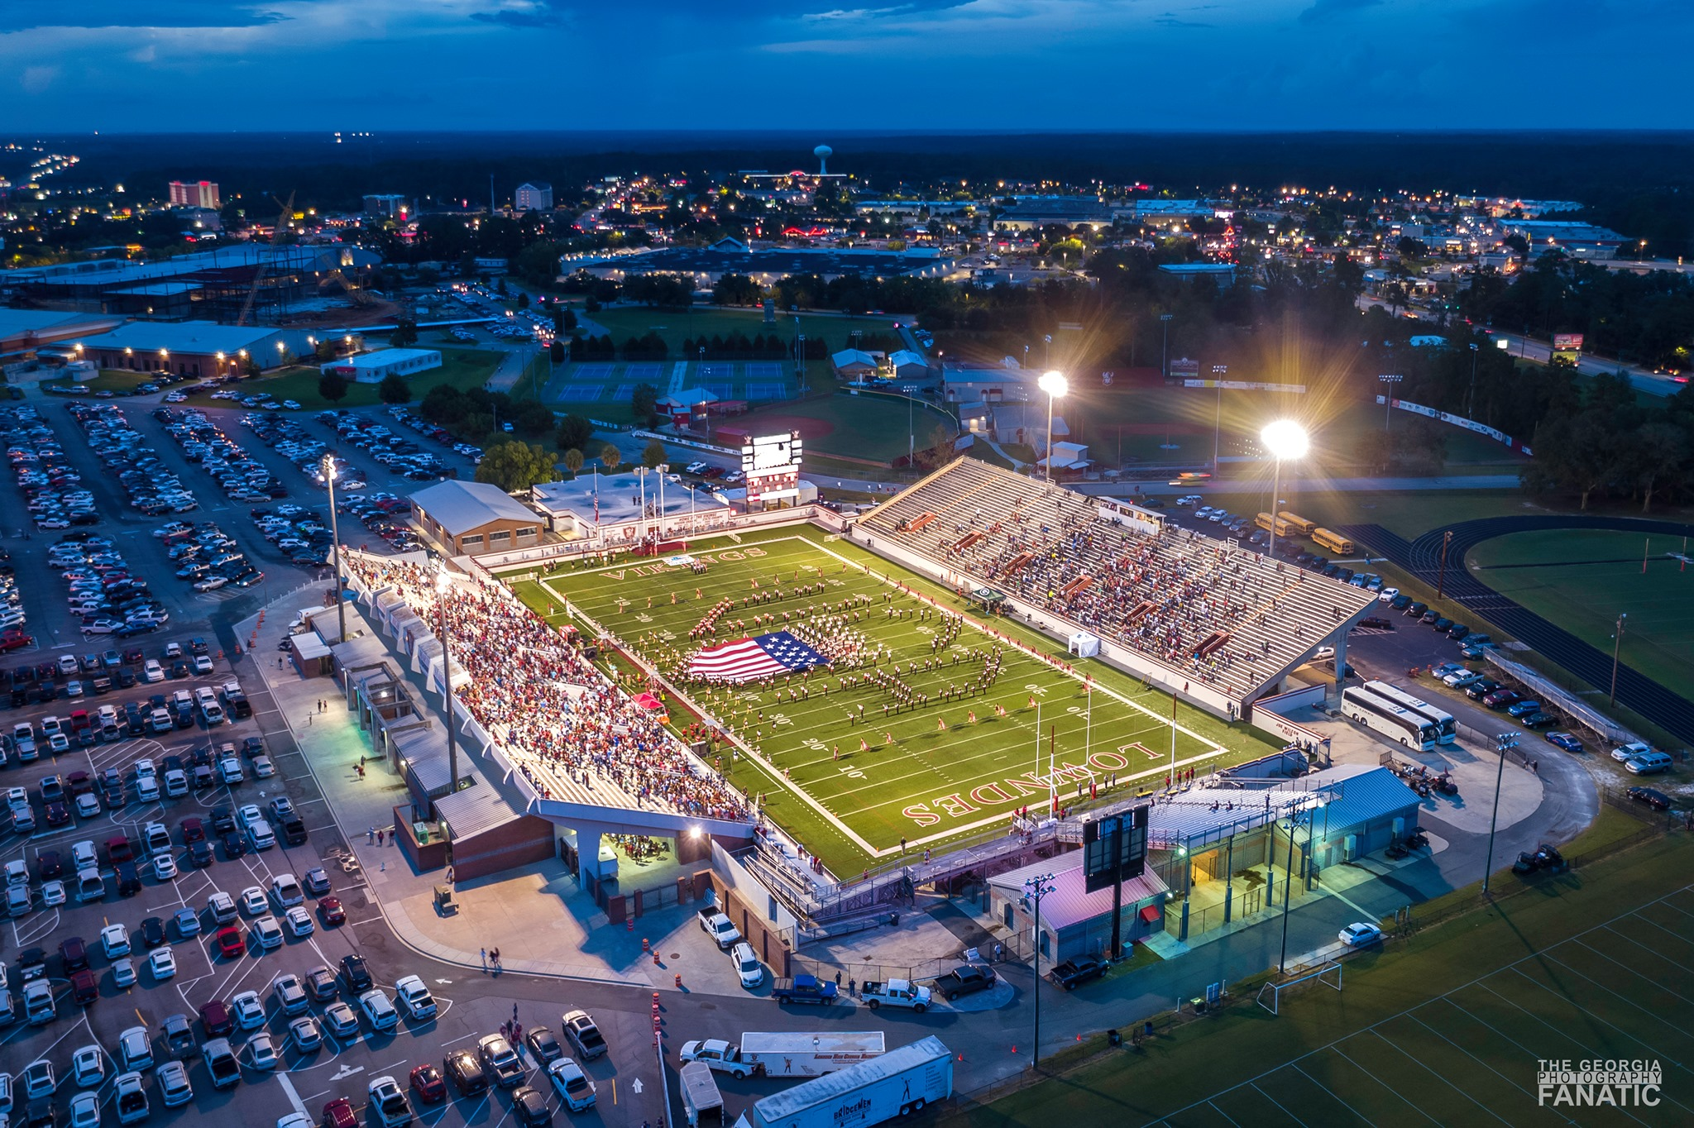
Questions

