Slide 1
LHS Band Booster Meeting Tuesday, July 20th, 2021

Slide 2
Agenda
Welcome
Approval Of June Meeting Minutes
Getting Involved
Fundraising Opportunities
Important Fall Dates
Band Store
Next Band Booster Meeting
Chaperone, Nurse, Bus Driver, P&P Meeting

Slide 3
Expectations for Your Band Member
Fall Calendars are available and will be posted to website tomorrow.
We practice on Mondays from 3:30-5:00, Tuesday and Thursday from 3:30-6:00.
Before you email me or call me, YES, you have to be at practice and all football games.
I hold all band students to a very high standard. We are a team and if you let down our team you will no longer be a part of our band program.

Slide 4
Band Trip to Orlando
It is not too late to sign up for the trip.
Please pick up a packet from Michael Spence at the conclusion of the meeting.
DO NOT PAY FOR YOUR TRIP ON THE REGISTRATION SITE. Only purchase the travel insurance if that is something you would like to do.
I need to intent form back by the end of band camp.

Slide 5
IMPORTANT FALL DATES
Cleanup Day- THANK YOU to all of the volunteers that helped us get ready for camp!!!
Picture Day is this Friday, July 23rd...7:30am in Big Gym
Band Camp Week 2 - 8:00-8:30pm...both meals provided
First Day of School - August 7th
Super Saturday Rehearsal - September 11th
Oconee Marching Contest - September 25th
Battle on the Border - October 16th
Waycross Contest - October 23rd

Slide 6
Corky Kell Kick off Game
The band will be traveling to the Corky Kell Game in Atlanta on Saturday, August 21st.
Kick Off is at 2:45pm
A detailed itinerary will be out soon.
All chaperones, bus drivers, nurses, etc. will need a ticket to enter the game.

Slide 7
2021 Booster Officer’s
President- Chris Buescher
Vice-President- Michael Spence
Secretary- Suzanne Tanner
Treasurer- Kevin Hiers
Member-at-Large- Jocelyn Norman

Slide 8
Secretary’s Report-Approval of Previous Meeting Minutes

Slide 9
Getting Involved
There are lots of ways to get involved with the Bridgemen
We WANT parents involved (must complete background check)
Areas to serve-
Water
Nurse
Bus Driver
Prop & Pit
Chaperone (Home and Travel)
Uniforms

Slide 10
Getting Involved
We will have a meeting for all volunteers that attended the Background Check meeting in June on Tuesday, August 10th at 6:00 pm.
If you would still like to get involved, please see Jocelyn Norman or Jennifer Green tonight to complete your Background Check forms (we will present the LCS Required Slideshow again at the August meeting for those who were not at the June meeting)

Slide 11
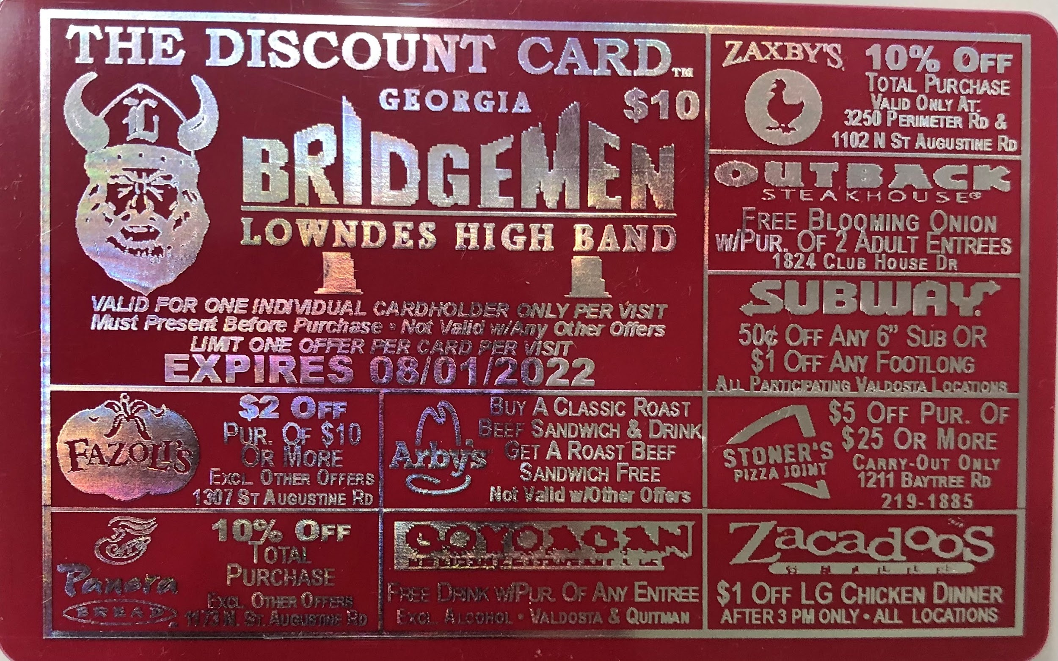
Fundraising Opportunites
Discount Cards-

Slide 12
Fundraising Continued
State Farm Quotes for Good

Slide 13
Quotes for Good™
Paul Cribbs State Farm
3565 N Crossing Cir
227-247-7127
paul@paulcribbs.net

Slide 14
State Farm- 3 Easy Steps
Get out your cell phone.
Write down ten names and their number.*
3. Tell them we will call them with a quote.
For every quote we provide*, we will donate $10 to your student’s account. Multiple sheets can be submitted!
*One Name per Household, GA residents & 18 or older

Slide 15
Band Store
Our Band Store will be open tomorrow/Thursday from 4-5pm
Camp Week from 6-8 pm
Please see Shannon Tabor for deals on previous seasons T-shirts (3/$10)

Slide 16
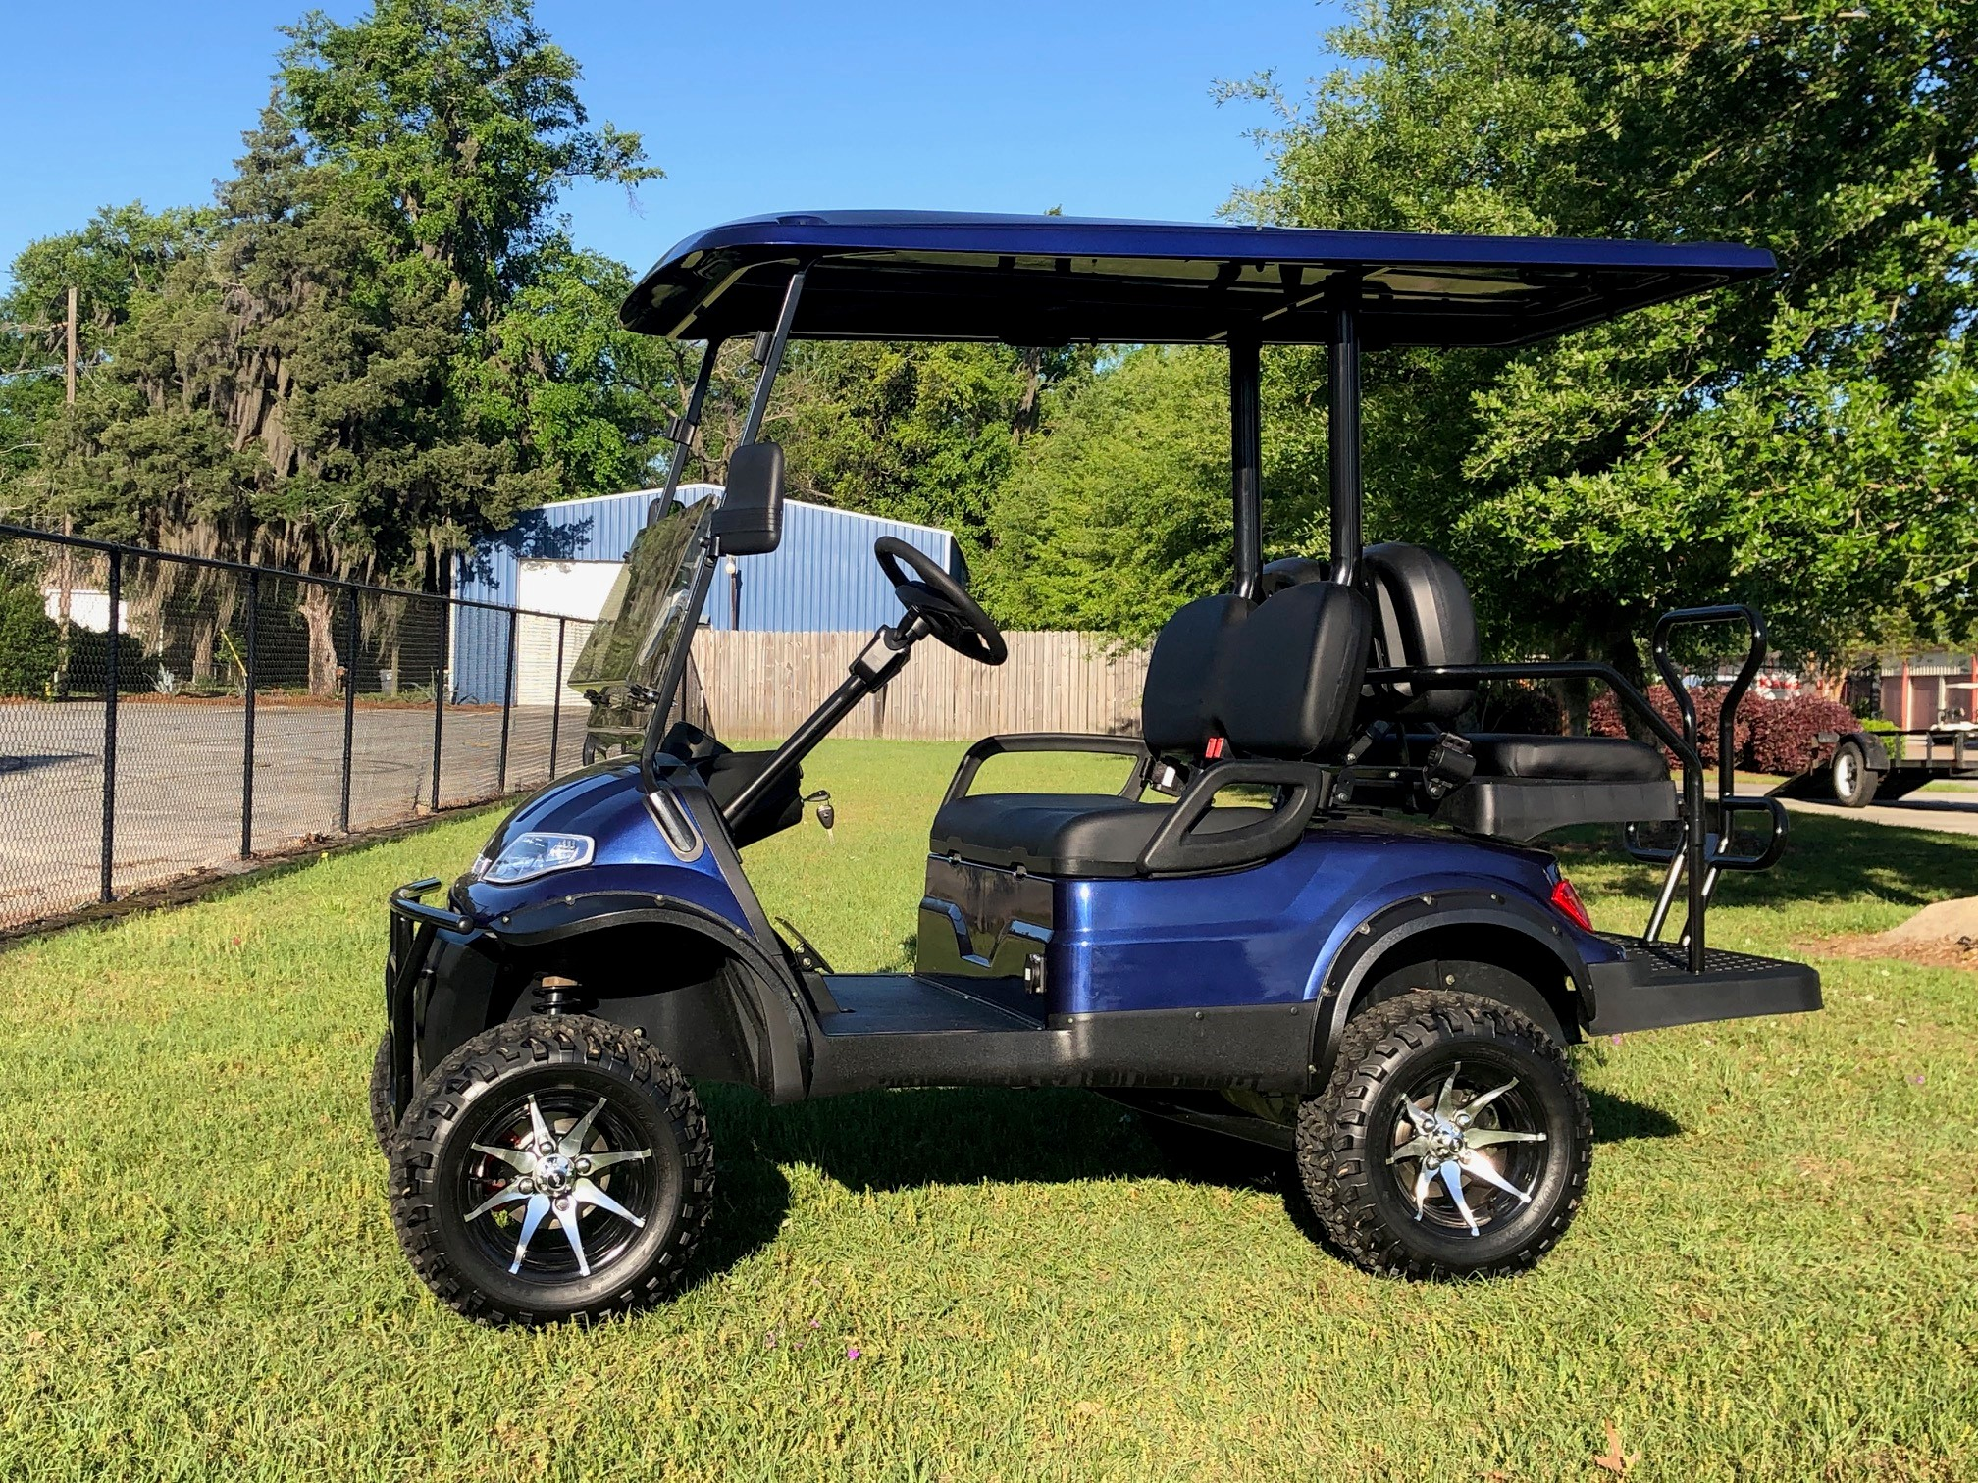
Electric Vehicle Raffle
Our annual Golf Cart Raffle (now an Advanced EV for 2021) tickets are on sale. Please see Shannon Tabor tonight for your chance to win. Tickets are only $5 each and the drawing will be held on Friday, October 22nd. The value of this Advanced EV is $9,000!

Slide 17
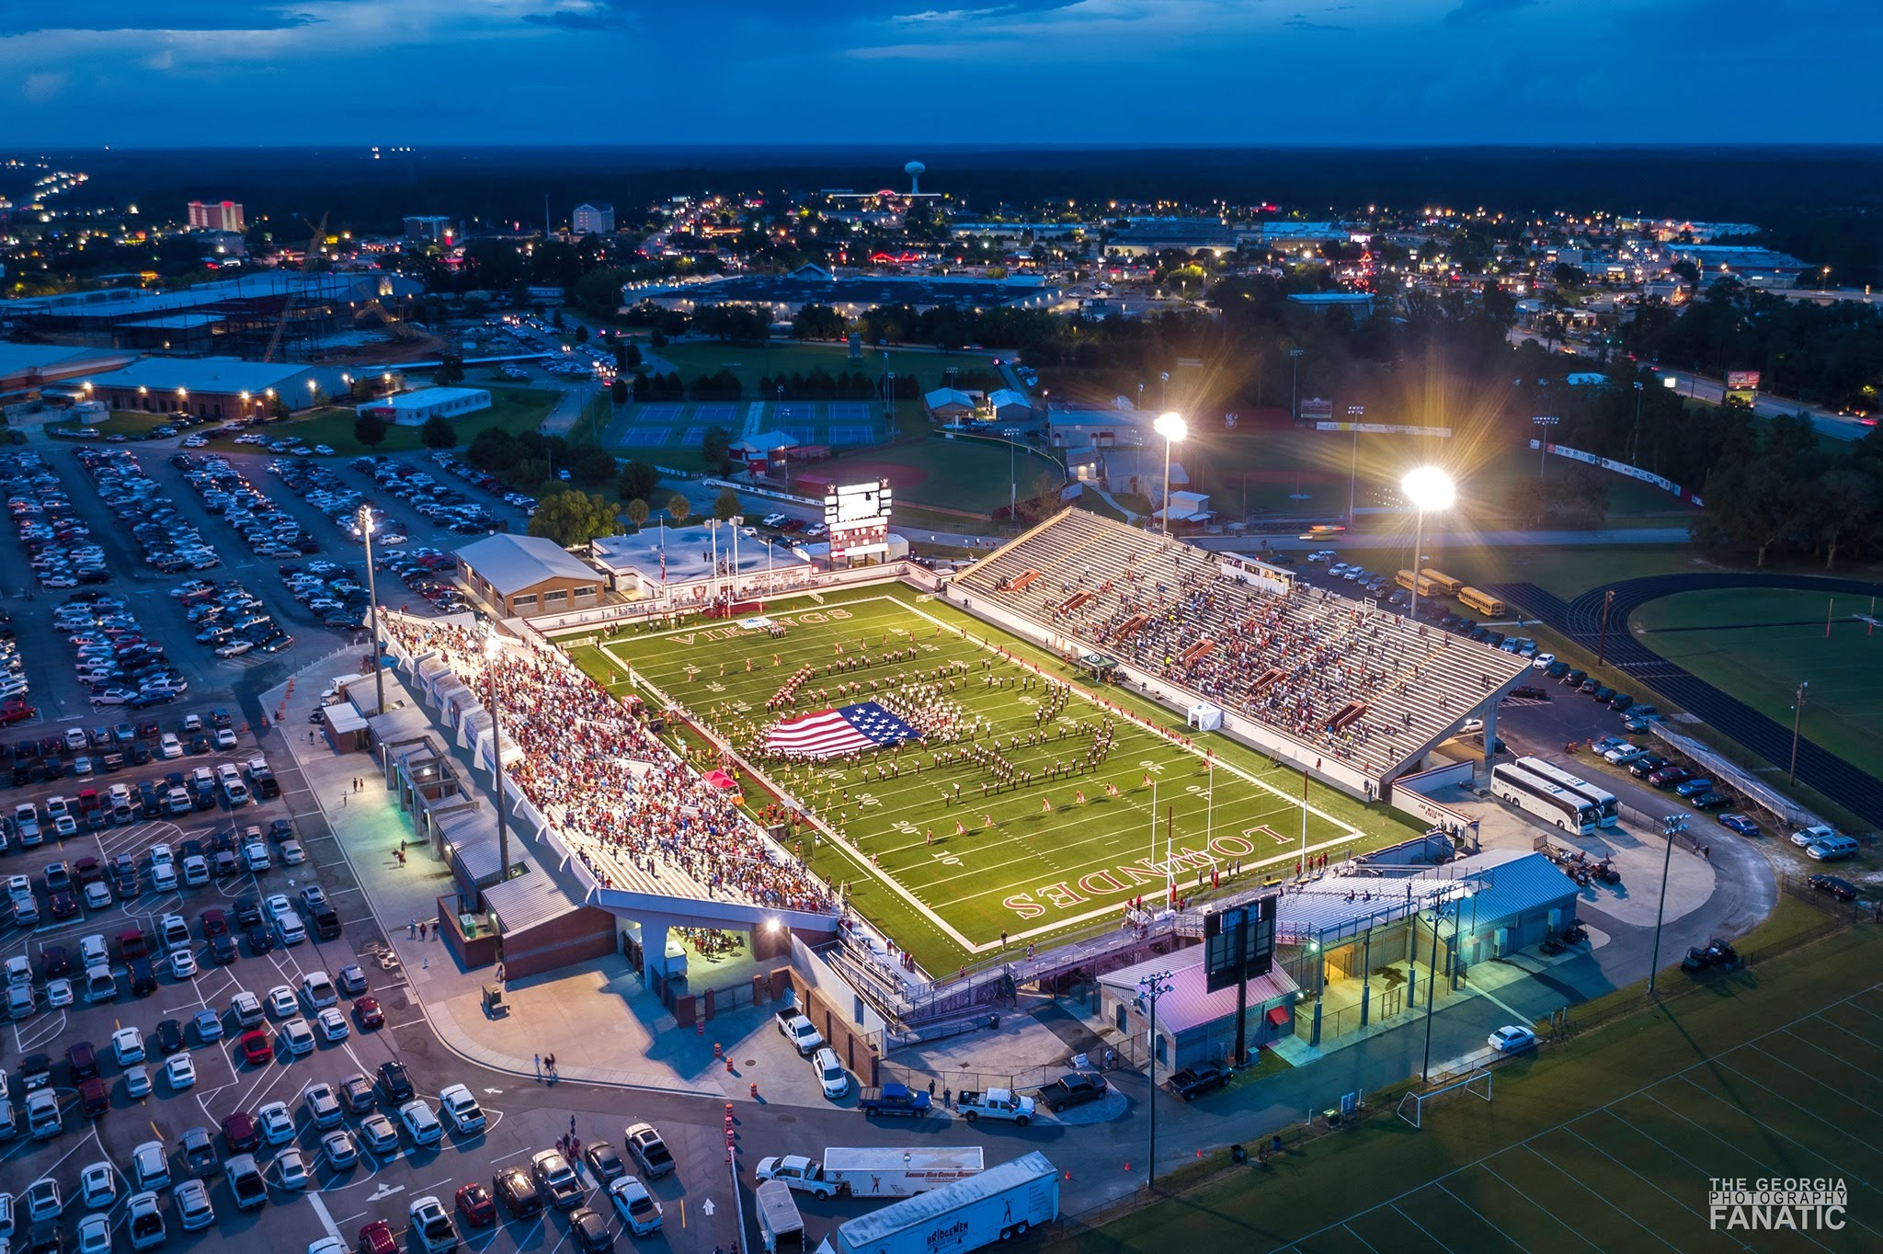
Questions

Slide 18
Volunteer ONLY Meeting
VOLUNTEER ONLY MEETING
Tuesday, August 10th @ 6:00 PM Band Room

Slide 19
Next Booster Meeting Tuesday, August 24th @ 6:00 PM Cafeteria

