Slide 1
LHS Band Booster Meeting Monday, February 22nd, 2021

Slide 2
Agenda
Welcome
Director’s Comments
Secretary’s Report
Approval of Minutes from previous meeting
Treasurer’s Report
Committee Chair Reports/Announcements
Next Band Booster Meeting

Slide 3
Winter Guard, Indoor and Concert Band Updates
Winter Guard (Varsity and Junior Varsity)
Indoor Percussion
Spring Concert Bands

Slide 4
IMPORTANT SPRING DATES
Thursday, February 25th- 9th Grade Interest Meeting (6:00)
Saturday, February 27th- WG Contest
Saturday, March 6th- WG and IP Contest
Thursday, March 11th- 9th Grade Signing Day
Saturday, March 13th- WG and IP Contest
Saturday, March 20th- WG Varsity Camp 1-6 pm
Sunday, March 21st- WG JV Camp 1-6pm
Monday, March 22nd- Booster Meeting and Friends and Family Event
Friday, March 26th-28th- WG and IP FFCC Championships, Daytona
Monday, April 5th- 9th- Spring Break
Monday, April 26th- Spring Concert A- 7:00 pm
Tuesday, April 27th- Spring Concert B- 7:00 pm

Slide 5
Secretary’s Report-Approval of Previous Meeting Minutes

Slide 6
OUTDOOR RAFFLE and GOLF TOURNAMENT
The Boosters Spring Outdoor Raffle. The drawing will be at Friends and Family on March 22nd (6 winning tickets will be drawn)
Birdies for Bridgemen Golf Tournament in May (Brochures going out soon)

Slide 7
2021 FOOTBALL PROGRAM AD SALES
A GREAT way to raise money for your student's account
(7) Home Games for 2021 and possibly (8). Big home games are Valdosta and Colquitt with another major announcement possibly coming
20% of all Ad sales goes to your student’s account (excludes Senior Ads)

Slide 8
BUS DRIVERS NEEDED
The Bridgemen NEED YOU! Although our need for drivers is a few months off, please don’t delay in getting your CDL to be ready for the fall marching season!
Please contact Chris Buescher at 229-292-2028 to get the process started.

Slide 9
2021 Booster Officer’s
President- Chris Buescher
Vice-President- Michael Spence
Secretary- Suzanne Tanner
Treasurer- Kevin Hiers
Member-at-Large- Jocelyn Norman

Slide 10
Treasurer’s Report

Slide 11
2021 COMMITTEES
Chaperones- Jocelyn Norman
Football Programs – Casey Thompson
Nurses – Mandy Anderson
Bus Drivers – Chris Buescher
Prop & Pit – Michael Spence
Uniforms – Tamara Oglesby
Water – Rhonda Waldroup

Slide 12
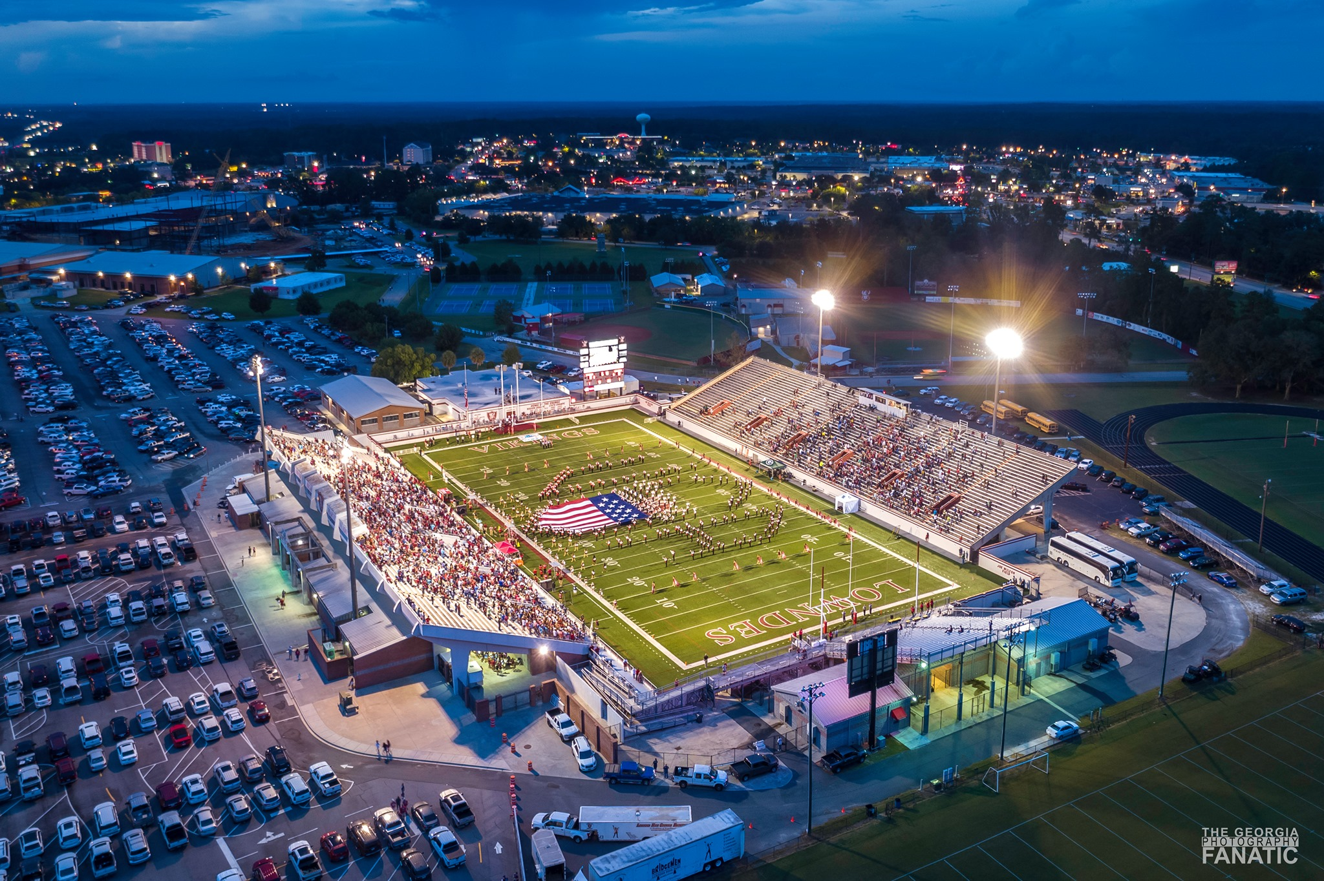
Questions

Slide 13
Next Booster Meeting Monday, March 22, 2021 (prior to “Friends & Family” event)

