Slide 1

LHS Band Booster Meeting
Tuesday, October 27th, 2020

Slide 2
Agenda
Welcome
Director’s Comments
Secretary’s Report
  Approval of Minutes from previous meeting
President’s Comments
Treasurer’s Report
Committee Chair Reports/Announcements
Next Band Booster Meeting-Called Meeting

Slide 3
Update on our fall Marching Season
  COVID-19 Update- moving the band to the visitor's side to allow for more spacing – Sections O and P
  Contest- November 7th in Jacksonville
  8th Grade Night – postponed, working on another date, likely during playoffs
  Senior Banquet will be Dec. 15. More info later.

Slide 4
IMPORTANT DATES FOR THE FALL
October 29th – After School Rehearsal 3:30-6:00
Winter Guard Informational Mtg 6:00pm (Cafe)
October 30th – Lowndes vs. Tifton – 8:00pm
November 2nd – After School Rehearsal – 3:30-6:00
November 3rd – After School Rehearsal – 3:30-6:00
November 4th – After School Rehearsal – 3:30-5:00
November 5th – After School Rehearsal – 3:30-6:00
November 6th – Lowndes vs. Colquitt (Away) – 7:30pm
November 7th – Competition at Ridgeview High School
in Jacksonville, FL
November 12th – After School Rehearsal – 3:30-5:00
November 13th – Lowndes vs. Camden – 8:00pm
November 16th-18th – WG Clinic – 4:00-7:00
November 19th – WG Tryouts – 4:00-Until
November 27th – 1st Round of Playoffs
December 3rd – After School Rehearsal – 3:30-5:00
December 4th – 2nd Round of Playoffs
December 5th – Valdosta Christmas Parade
December 10th – After School Rehearsal – 3:30-5:00
December 11th – 3rd Round of Playoffs
December 15th – Senior Banquet
December 17th – After School Rehearsal – 3:30-5:00
December 18th – 4th Round of Playoffs
December 19th-20th – Varsity WG Staging Camp
December 21st-22nd – JV WG Staging Camp
December 30th – State Championship Game

Slide 5
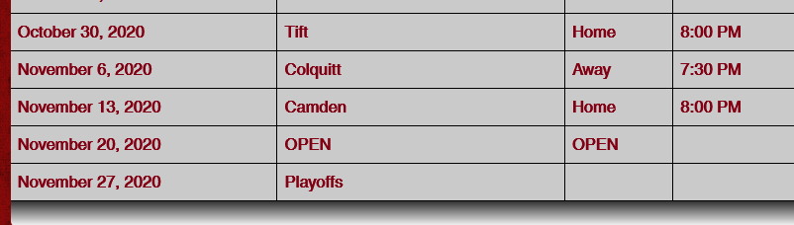
Varsity Football Schedule-UPDATED

Slide 6
Secretary’s Report-Approval of Previous Meeting Minutes
Approval of Minutes from September meeting:
Motion made by Glen Langston
Seconded by Kim Hatton

Slide 7
We Want You!
Calling all parents. We WANT YOU to be a part of the Bridgemen Family. Please see Suzanne Tanner after the meeting to see how you can get plugged into being a part of the Bridgemen. 229.415.1651

Slide 8
BUS DRIVERS STILL NEEDED
If you are interested in obtaining you bus driver’s license, please see Chris Buescher at the conclusion of tonight’s meeting. We could still use several more to get us through the year and moving on into next year.

Slide 9
DISCOUNT CARDS ARE AVAILABLE
Discount Cards available tonight.
Card is $10/sale and students receives $5 credit.

Slide 10
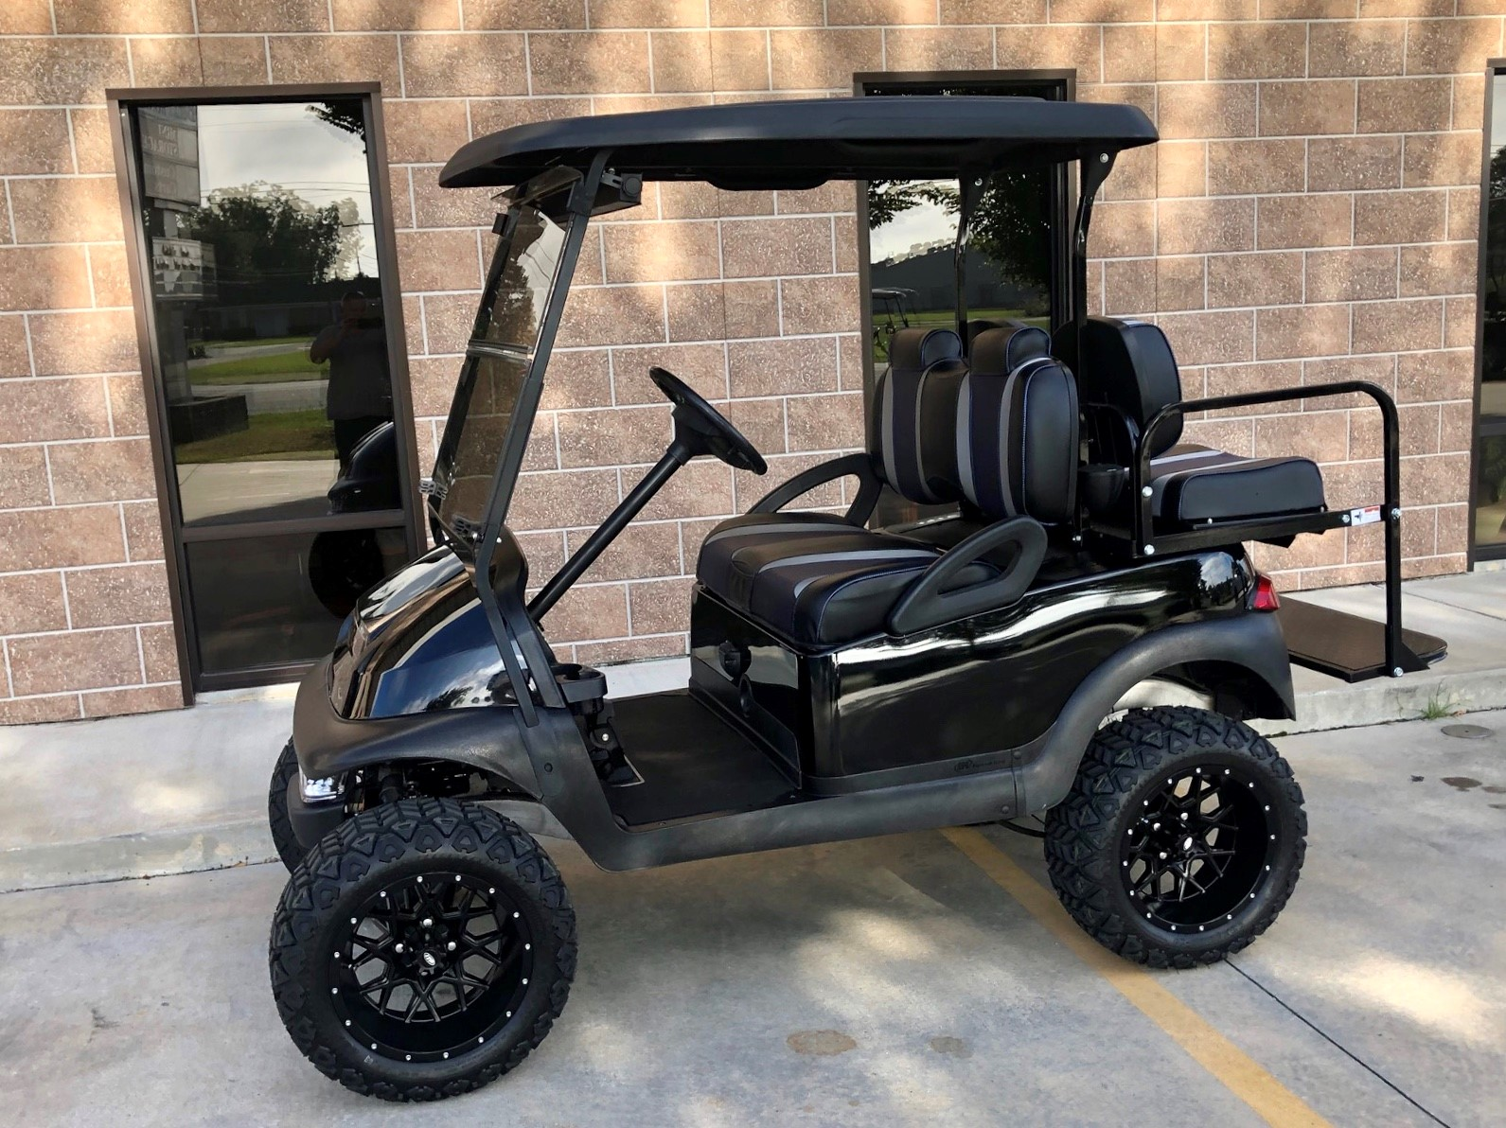
GOLF CART RAFFLE
Golf Cart Raffle tickets ($5) are available tonight. Golf Cart is on display at Austin’s Steakhouse. Valued at $7000. Tickets can also be purchased at Austin’s as well.

Slide 11
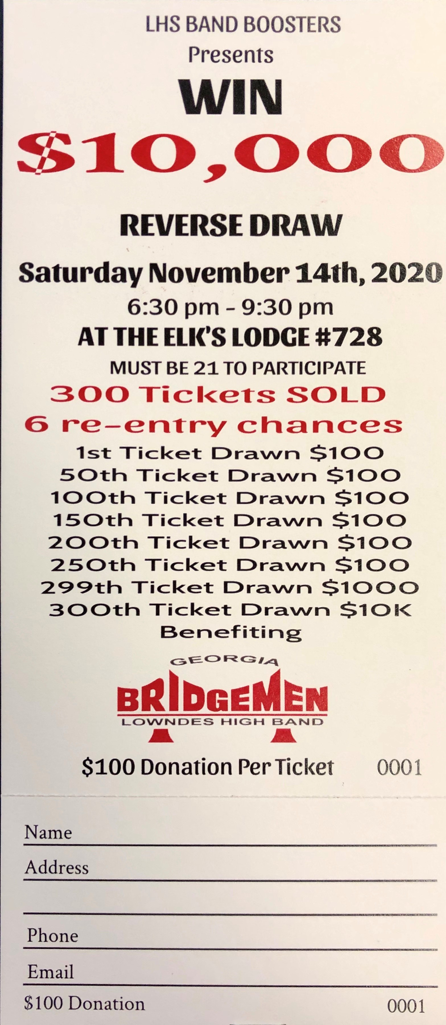
Reverse Draw- November 14th
Our 3rd Annual Reverse Draw will be held Saturday, November 14th
$100 donation for a chance to win $10,000
Each ticket permits two people to attend the event, with heavy hors d’oeuvres.
You do not have to be present to win.
See any Booster officer to purchase tickets.

Slide 12
2021 Officer Nominations
The following individuals have been nominated for 2021. The official election will occur at the November Booster meeting.
President- Chris Buescher
Vice-President- Michael Spence
Secretary- Suzanne Tanner
Any nominations from the floor?

Slide 13
State Farm- Quotes For Good
A great way to earn $10/name & phone number to your student’s account
In 2019- parents earned $4,100 towards their student’s band account
It’s easy and HASSLE FREE!!!
Video from Paul Cribbs

Slide 14
A.R.F.
The key to a successful marching system is summed up in this acronym:
A- Absolute
R- Rigid
F- Flexibility

Slide 15
Treasurer’s Report

Slide 16
Committee Chair Reports

Slide 17
2020 Band Booster Committee Reports
Band Store - Tabor
Chaperones - Tanner
Programs - Buescher
Nurses - Anderson
Bus Drivers - Buescher
Prop & Pit – Spence/Langston
Uniforms - Oglesby
Water – Waldroup

Slide 18
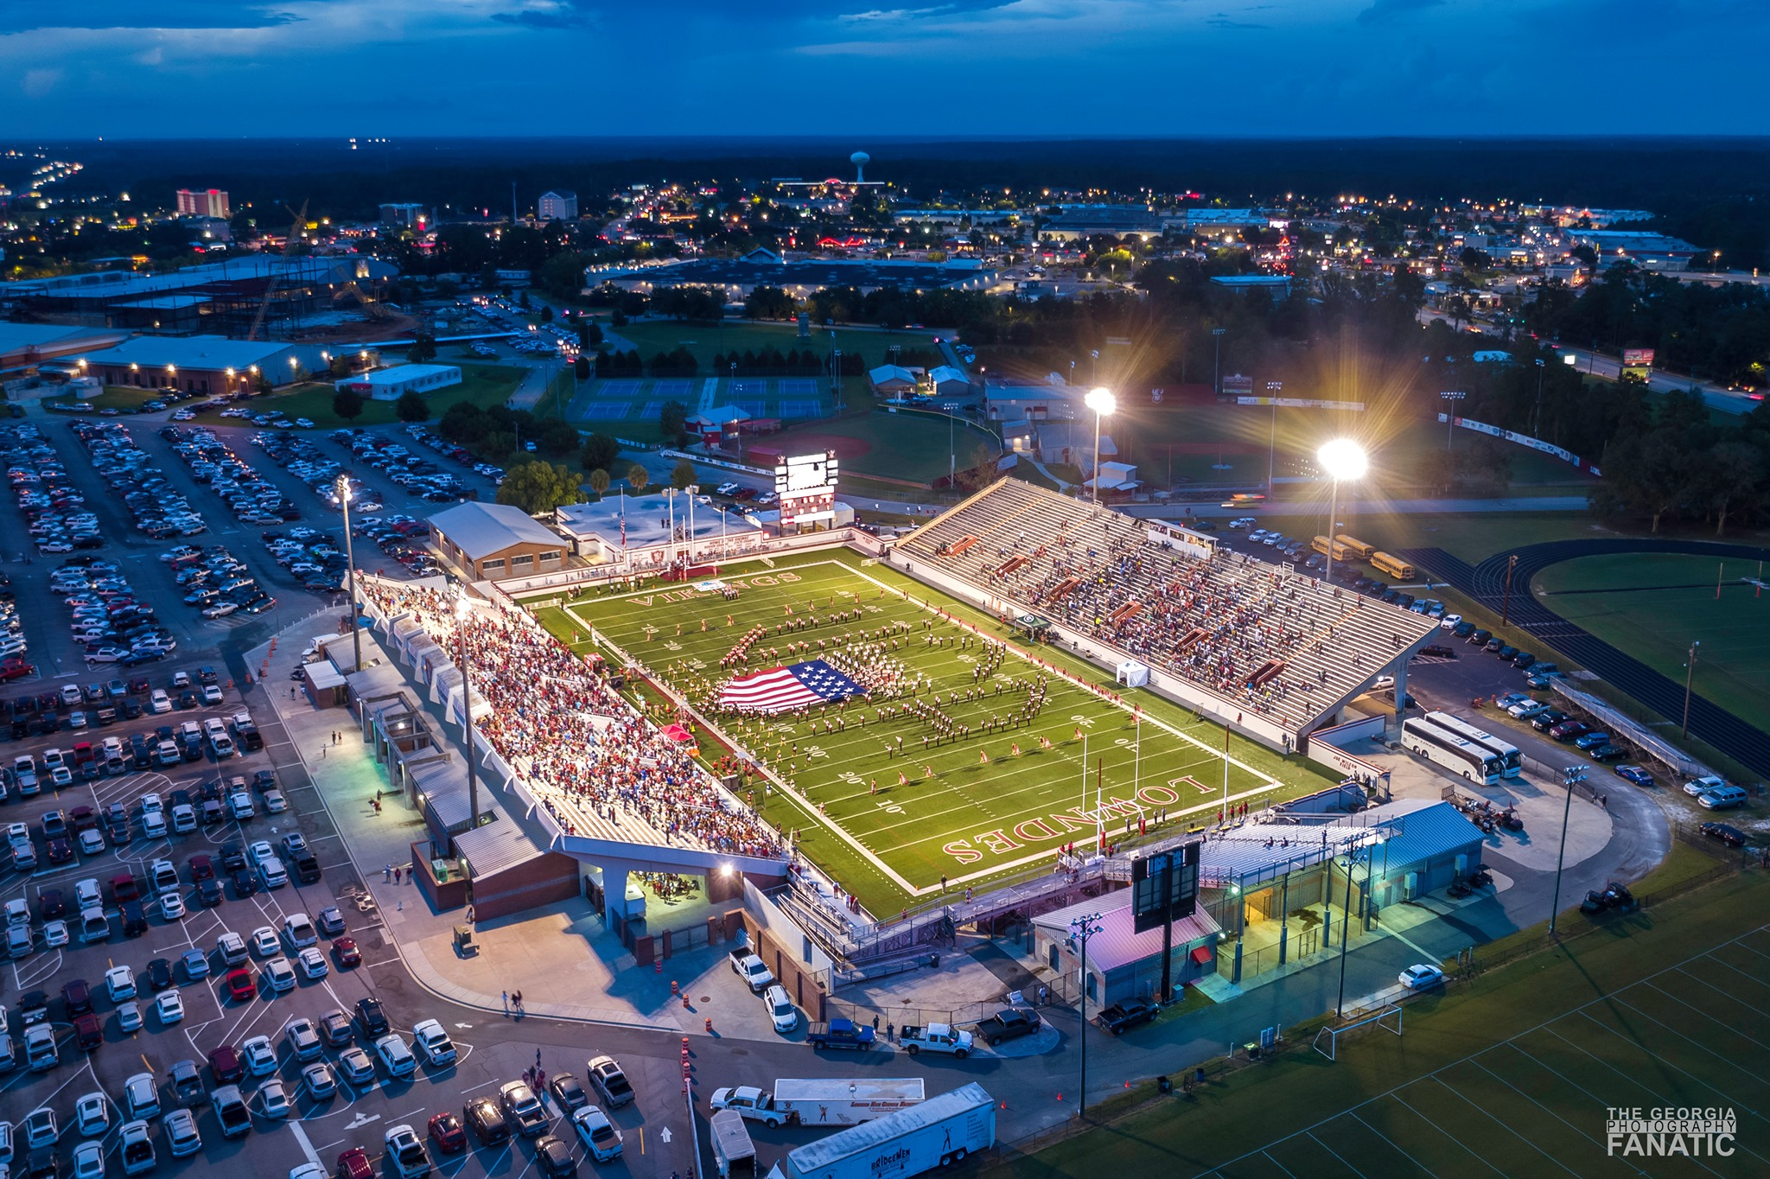
Questions

Slide 19
Next Booster Meeting
Monday, November 30th @ 6:30 PM
LHS CAFETERIA

