Slide 1
LHS Band Background Check Meeting Monday, June 28th, 2021

Slide 2
Agenda
Welcome
Director’s Comments
Important Marching Season Dates
Next Band Booster Meeting
Chaperone Shirts/attire
Background Check Powerpoint

Slide 3
IMPORTANT FALL DATES
Cleanup Day- Saturday, July 10th at 8:00 am
Rookie Camp- Thursday, July 15th
Pre-Camp begins- Monday, July 19th
MANDATORY PARENT MEETING- Tuesday, July 20th at 6:00 pm (cafeteria)(Discount Cards will be available)
Picture Day- Friday, July 23rd
Band Camp begins- Monday, July 26th
Talent Show/Band Dance- Friday evening, July 30th
Future Bridgemen Camp (Auxiliary)- Saturday, August 14th

Slide 4
Important Fall Dates continued
Corky Kell Kickoff Game at the Mercedes Benz Stadium- Saturday, August 21st. 2:45 pm kickoff. Estimated departure time is 8:00 am
AWAY Game vs Lee Co- Friday, September 10th. 7:30 pm kickoff. Estimated departure time is 4:30 pm
SUPER SATURDAY PRACTICE- Saturday, September 18th
Oconee Classic Contest- Saturday, September 25th, Milledgeville, GA

Slide 5
Important Fall Dates Contiunued
Honeybee Parade- Saturday, October 2nd
AWAY Game vs Tift Co.- Friday, October 15th .7:30 pm kickoff. Estimated departure time is 5:30 pm
Battle on the Border- Saturday, October 16th- ALL DAY
Sound of Gold Contest- Saturday, October 23rd, Waycross, GA
AWAY Game vs Camden Co.- Friday, October 29th.7:30 pm kickoff, Estimated departure time is Noon

Slide 6
Important Fall Dates Continued
Fall Band Trip to Orlando- Thursday, Nov 4th-7th
1st Round of the Playoffs- Friday- November 12th
REVERSE DRAW- Saturday, November 13th at the Elks Lodge. Begins at 6:00 pm

Slide 7
Chaperone Shirts/Attire
Please see Shannon Tabor tonight to place your shirt order

Slide 8
2021 Booster Officer’s
President- Chris Buescher
Vice-President- Michael Spence
Secretary- Suzanne Tanner
Treasurer- Kevin Hiers
Member-at-Large- Jocelyn Norman

Slide 9
2021 COMMITTEE Chairs
Chaperones- Jocelyn Norman
Football Programs – Casey Thompson
Nurses – Mandy Anderson
Bus Drivers – Chris Buescher
Prop & Pit – Michael Spence
Uniforms – Tamara Oglesby
Water – Rhonda Waldroup

Slide 10
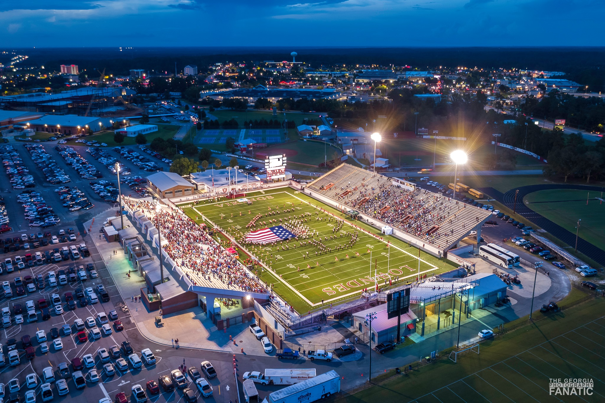
Questions

Slide 11
Next Booster Meeting Tuesday, July 20th @ 6:00 PM Cafeteria MANDATORY PARENT MEETING

