Slide 1

LHS Band Booster Meeting
Tuesday, September 22, 2020

Slide 2
Agenda
Welcome
Director’s Comments
Secretary’s Report
  Approval of Minutes from previous meeting
Treasurer’s Report
Committee Chair Reports/Announcements
Next Band Booster Meeting-Called Meeting

Slide 3
IMPORTANT DATES FOR THE FALL
The first day of school every student received a class syllabus and calendar with dates for the fall. Please make sure that you have reviewed this.
We practice after school
  Mondays until 5:00pm
  Tuesday and Thursdays until 6:00pm
  Percussion and Auxiliaries may have sectionals on Mondays until 6:00pm
  The weeks of marching contests we will practice Monday-Thursday until 6:00pm. Wednesday we will release at 5:00pm

Slide 4
IMPORTANT DATES FOR THE FALL
DRIVE ONE 4UR SCHOOL-Update
SEPTEMBER 26th – Contest #1 – Rehobeth High School, Dothan
OCTOBER 9th- Winnersville Classic at Valdosta
OCTOBER 10th – Contest #2 – Daleville High School, Daleville
OCTOBER 17th – Battle on the Border
YES, WE PERFORM AT ALL FOOTBALL GAMES!!!!!

Slide 5
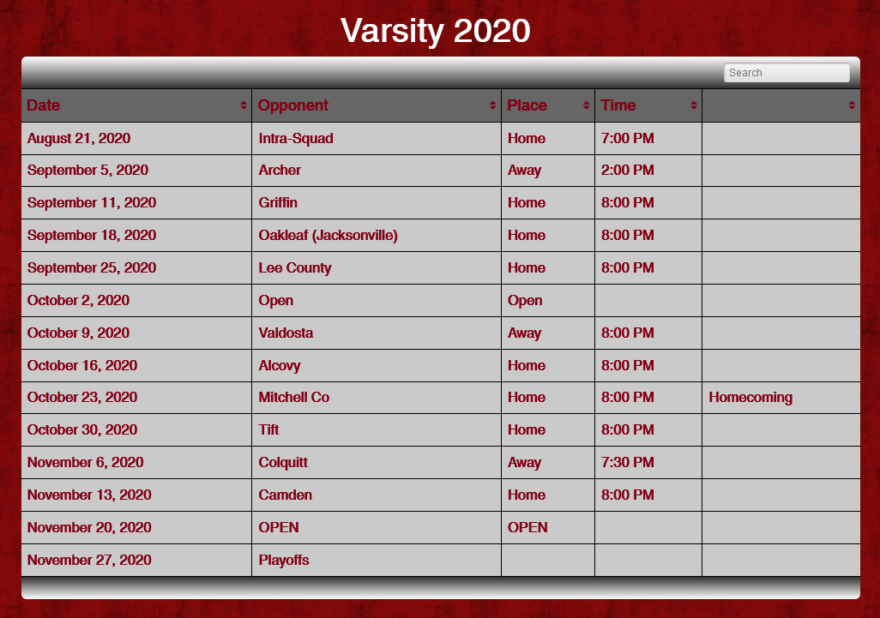
Varsity Football Schedule-UPDATED

Slide 6
Secretary’s Report-Approval of Previous Meeting Minutes

Slide 7
Super Saturday
A HUGE THANK YOU
To Everyone Involved!!!

Slide 8
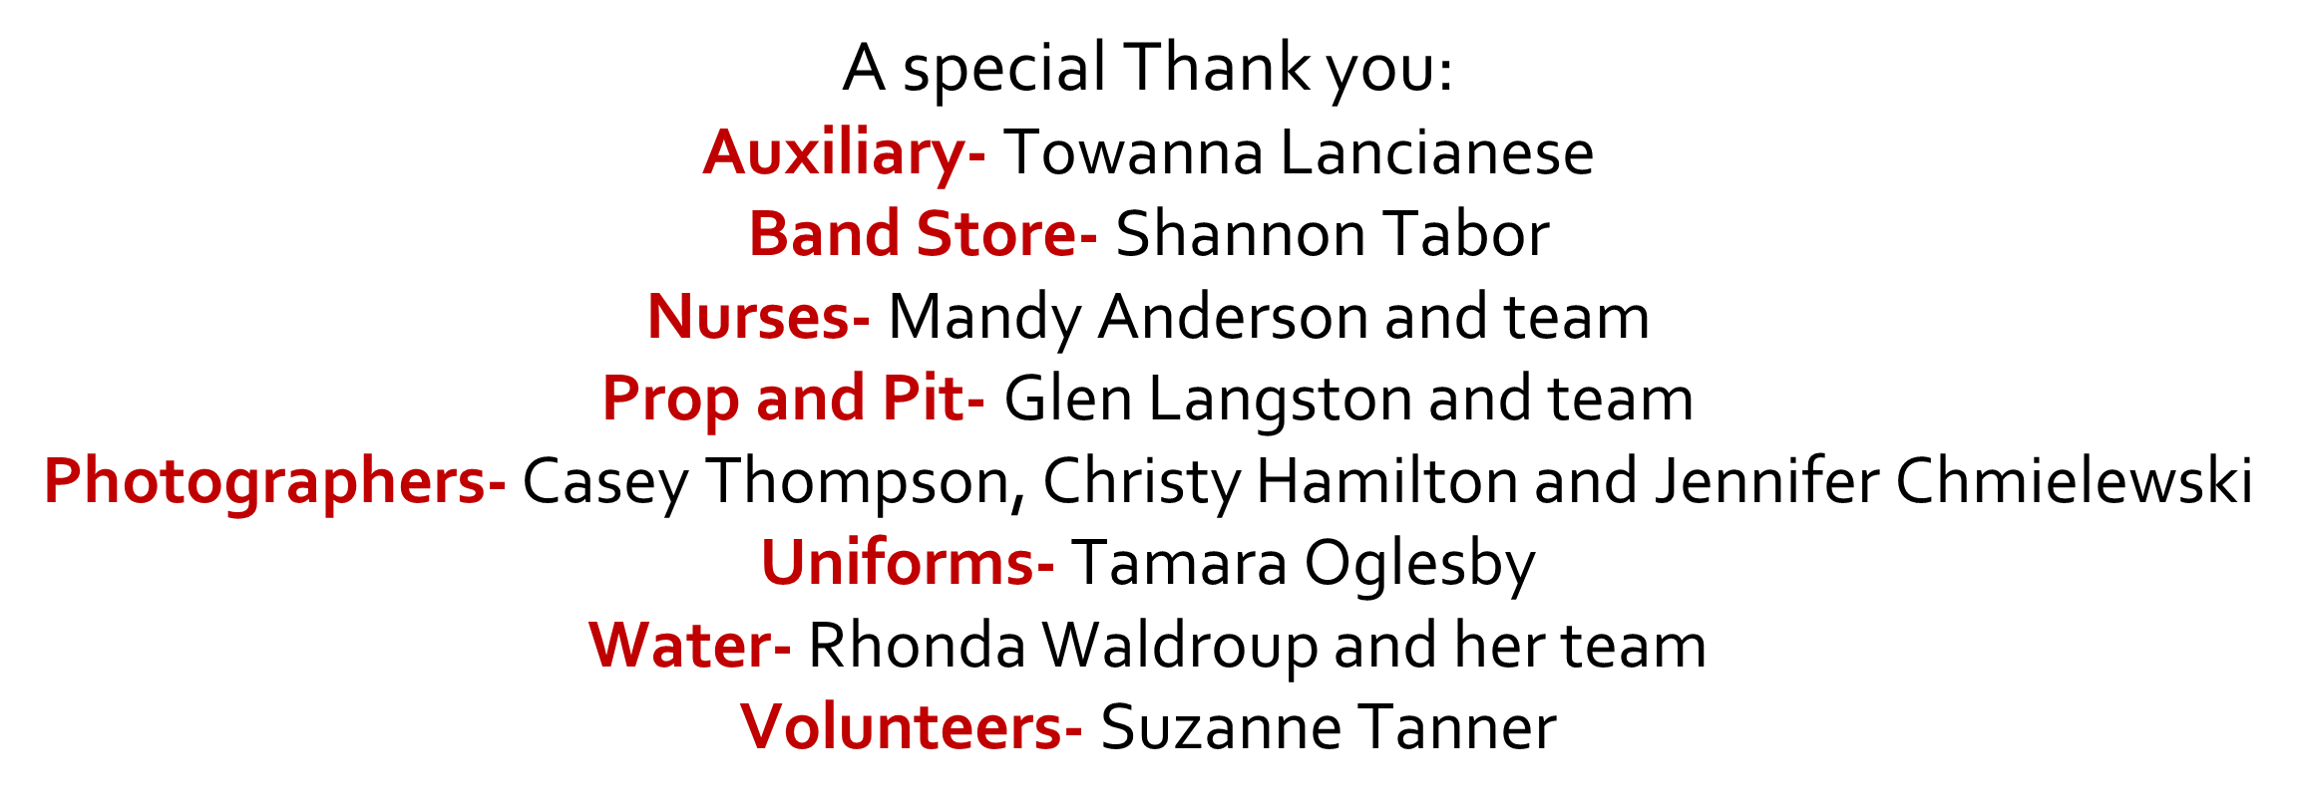
Super Saturday

Slide 9
We Want You!
Calling all parents. We WANT YOU to be a part of the Bridgemen Family. Please see Suzanne Tanner after the meeting to see how you can get plugged into being a part of the Bridgemen

Slide 10
BUS DRIVERS STILL NEEDED
If you are interested in obtaining you bus driver’s license, please see Chris Buescher at the conclusion of tonight’s meeting. We could still use several more to get us through the year and moving on into next year.

Slide 11
WATER FOR AFTER SCHOOL REHEARSALS
We are in desperate need for help with water during after school rehearsals. If you are able to be at the school around 2:45 to help get water set up, please see Rhonda Waldroup tonight at the meeting.

Slide 12
DISCOUNT CARDS ARE AVAILABLE
Shannon Tabor Discount Cards available tonight.
Card is $10/sale and students receives $5 credit.

Slide 13
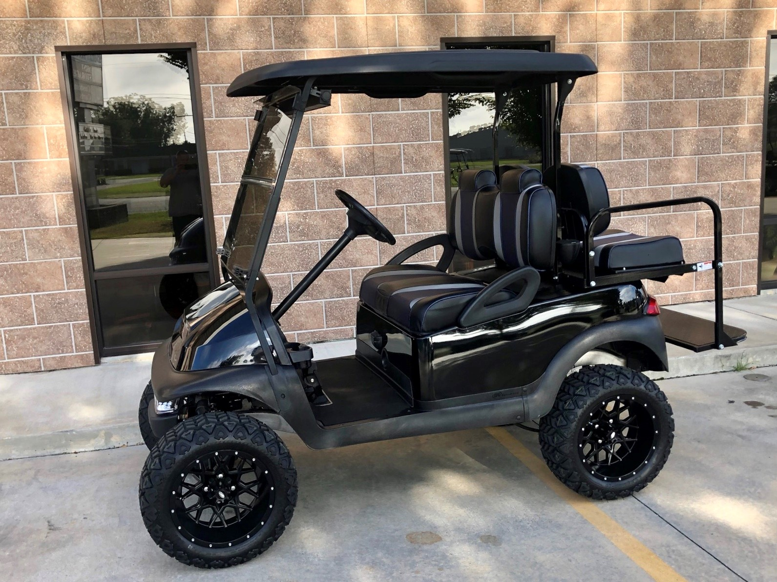
GOLF CART RAFFLE
Golf Cart Raffle tickets are available tonight. Golf Cart is on display at Austin’s Steakhouse. Tickets can also be purchased at Austin’s as well.

Slide 14
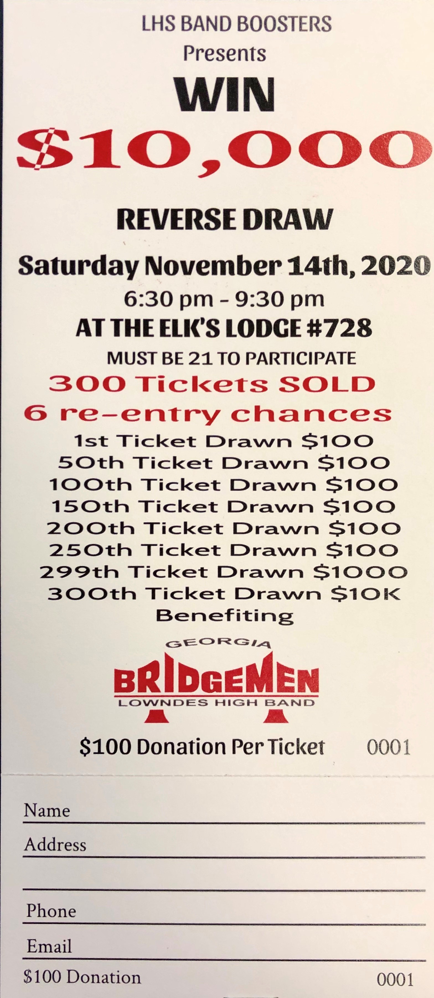
Reverse Draw- November 14th
Our 3rd Annual Reverse Draw will be held Saturday, November 14th
$100 donation for a chance to win $10,000
Do not have to be present to win

Slide 15
2021 Officer Nominations
Officer nominations are active through the October 26th Booster Meeting.
Nominating Committee is Salome McKee and Liska Hamm
President, VP and Secretary
Election is at the November Booster meeting

Slide 16
A.R.F.
The key to a successful marching system is summed up in this acronym
A- Absolute
R- Rigid
F- Flexibility

Slide 17
Treasurer’s Report

Slide 18
Committee Chair Reports

Slide 19
2020 Band Booster Committee Reports
Band Store - Tabor
Chaperones - Tanner
Programs - Buescher
Nurses - Anderson
Bus Drivers - Buescher
Prop & Pit – Spence/Langston
Uniforms - Oglesby
Water – Waldroup
Battle on The Border – Bowman/Buescher

Slide 20
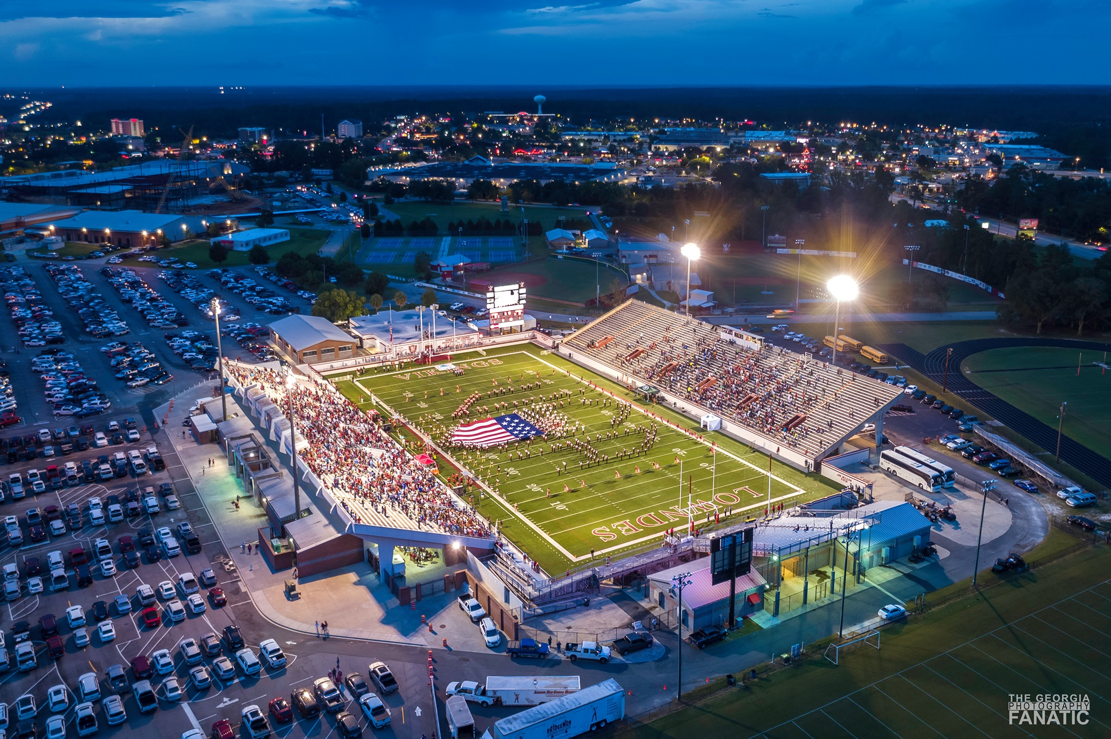
Questions

Slide 21
Tuesday, October 27th @ 6:30 PM
LHS CAFETERIA

