Slide 1

WELCOME!!!!!
Future Georgia Bridgemen
Informational Meeting

Slide 2
Agenda
  Welcome
  Did you pick up your packet upon entering?
  Information from Mr. Bowman
  Information from Dr. Grant on Percussion Auditions
  Information from Mr. Bowman on Color Guard Auditions
  Information from on Booster Club

Slide 3
Information Packet

Slide 4
Why Should I do Band?
Be a part of something bigger than yourself
Be a part of history
Be a part of the largest student organization at Lowndes High School
Experiences
Let’s look at some facts

Slide 5
National Research
From the Dana Consortium Report on Arts and Cognition
  Musicians scored better compared to non-musicians on a test of long-term verbal memory, but this advantage disappeared when the students were prevented from going through the activity of rehearsal.
  Children with early training in music had a higher degree of phonological awareness (auditory skill correlated with reading ability) that children with no musical training.
  Intensive music training is associated with improved performance in the core mathematical system for representing abstract geometry.

Slide 6
SIX-YEAR SAT SCORE COMPARISON
From Georgia All-State Musicians Compared to National Average
2011 – All-State Student = 1819, National Avg. = 1511
2012 – All-State Student = 1835, National Avg. = 1511
2013 – All-State Student = 1857, National Avg. = 1509
2014 – All-State Student = 1852, National Avg. = 1509
2015 – All-State Student = 1825, National Avg. = 1500
2016 – All-State Student = 1847, National Avg. = 1498
Georgia All-State Musicians scored on average 22% higher than the National Average

Slide 7
Honor Graduates
OF THE 82 SENIORS IN MARCHING BAND LAST YEAR…..
71 ARE PROJECTED TO BE HONOR GRADUATES!!!!!

Slide 8
WHY BAND?
SUCCESS IN SOCIETY
The US Department of Education lists the arts as subjects that college-bound middle and junior high school students should take, stating “Many colleges view participation in the arts and music as a valuable experience that broadens students’ understanding and appreciation of the world around them. It is also well known and widely recognized that the arts contribute significantly to children’s intellectual development.” In addition, one year of Visual and Performing Arts is recommended for college-bound high school students. – Getting Ready for College Early: A Handbook for Parents of Students in the Middle and Junior High Years, US Department of Education

Slide 9
Why Band?
SUCCESS IN SCHOOL
In an analysis of US Dept. of Education data on more than 25,000 secondary school students, researchers found that students who report consistent high levels of involvement in instrumental music over the middle and high school years show “significantly higher levels of mathamatics proficiency by grade 12.” This observation holds regardless of student’s socio economic status, and differences in those who are involved with music vs. those who are not is more significant over time.

Slide 10
Why Band?
Data from the National Education Longitudinal Study showed that music participants received more academic honors and awards than non-music students, and that the percentage of music participants receiving Associate/Bachelor degrees was higher than the percentage of non-participants receiving those grades. – NELS: First Follow Up, National Center for Education Statistics, Washington D.C.

Slide 11
Why Band?
SUCCESS IN DEVELOPING INTELLIGENCE
A research team exploring the link between music and intelligence reported that music training is far superior to computer instruction dramatically enhancing a child’s abstract thinking, reasoning skills and the skills necessary for learning math and science.

Slide 12
Why Band?
Success in Life
“The nation’s top business executives agree that art’s education programs can help repair weaknesses in American education and better prepare workers for the 21st century.” – “The Changing Workplace is Changing our View of Education.” Business Week
At perhaps no other time have music and arts education been more important. Apart from their obvious benefits, music and the other arts produce critical thinkers, people who are decision makers. In the information age, our company needs people with these critical thinking skills. Susan Driggers, Bell South Corporation

Slide 13
What You Will Learn in Marching Band
Early is on time; on time is late.
Time management is everything.
Kindness and generosity go far.
Teamwork makes the dream work.
Criticism is a natural part of life.
Shortcuts get you nowhere.

Slide 14
ACADEMICS vs. ELECTIVES
New HOPE Scholarship Requirements (Four “Rigorous” Classes)
What qualifies as a “Rigorous” Class?
  2nd year Foreign Language
  11th Grade Math (Advanced Algebra)
  Advance Math Decision Making
  11th Grade Science (Chemistry)
  12th Grade Economics (AP)
  12th Grade Science (Anything AP, Physics and Human Anatomy)
  12th Grade Math (Anything AP, Pre-Calculus, Statistics
  Every student must also complete a pathway. 3 years of band can be your pathway in Fine Arts.
  Driver’s Education offered in the Summer and he works very closely with us not to interfere with band.

Slide 15
Band and Other Activities
YOU CAN DO BAND AND BE INVOLVED IN OTHER ACTIVITIES
OUR STUDENTS IN BAND ARE ALSO LEADERS IN MANY OTHER ACTIVITIES AT SCHOOL:
Drama
Chorus
ROTC
Mock Trial
TSA
Baseball
Soccer

Slide 16
WHAT HAPPENS NEXT????
We have to discuss the financial commitment
We have to discuss the time commitment
We have to discuss the student/parental commitment

Slide 17
9th GRADE SIGNING DAY
On Tuesday, March 10th we will be holding our first ever Georgia Bridgemen Signing Day.
Where: LHS Cafeteria
Time: 5:30-8:00
At this time you will turn in your Paperwork and be fitted for your uniform.
You will need to pay the following at this event:
$75 to LHS Band Boosters for your vest, bow tie and shoes
$100 to White Wedding for your tux shirt and pants

Slide 18
Band Fees
Band Fee:$350 If you have a second child, fee is $300 for second child.
May 15th – 1st Band Fee Payment - $100.00 payable to LHS Band Boosters
June 15th – 2nd Band Fee Payment - $125.00 payable to LHS Band Boosters
July 21st – 3rd Band Fee Payment - $125.00 payable to LHS Band Boosters
If we have not received $350 by July 21st a 4th Band Fee Payment will be added of $25.00
These payments need to be mailed to the following address:
LHS Band Boosters
PO Box 2712
Valdosta, GA 31604
Rental Fee of $20 payable to Lowndes High School will be due on Instrument Check out Day, July 14th . This is for anyone playing a school owned instrument.

Slide 19
WHEN MAILING A CHECK
PLEASE…..ALWAYS INCLUDE YOUR
STUDENT’S NAME ON THE
MEMO LINE OF THE CHECK!!!!

Slide 20
Commitment of Your Time

Slide 21
Please Think Through What This Means
Can I attend all rehearsals, games and competitions?
Can I push through a long fall with a great attitude, great work ethic and making the band the best it can be?
It takes every single one of us being on the same page to make this work.
Please do not turn in commitment form if you think there is a chance you will not do band. We base our drill numbers off of these forms.

Slide 22
Summer and Fall Calendar
July 16 – (9:00-5:00) – Rookie Camp – Lunch Provided
July 20-23 – (9:00-5:00) – Pre Band Camp
(9:00 – 8:00) – Color Guard
July 21st – Mandatory Student/Parent Meeting 6:00pm in Cafeteria
July 24 – (7:30am) – Picture Day in Gym
July 27 – 30 – (8:00-8:30) - Band Camp (Dinner Provided)
PLEASE SEE ATTACHED FALL CALENDAR!!!!!!!!!!

Slide 23
STAY INFORMED!!!!!!

Slide 24
FACEBOOK AND REMIND 101
WEBSITE:
www.georgiabridgemen.org
FACEBOOK:
Lowndes High Georgia Bridgemen
Band App:
Download the Band App from the App Store and join Lowndes High Georgia Bridgemen
WEBSITE FOR LOWNDES PERCUSSION
www.lowndespercussion.com
Twitter: @gabridgemen

Slide 25
Percussion Auditions
Percussion Auditions will be held:
April 30th – 4:00-6:000 – LHS Band Room
May 1st – 4:00-5:30 – LHS Band Room
May 2nd – 9:00-Noon – LHS Band Room
At conclusion of meeting Dr. Grant will meet with all percussionists.

Slide 26
Auxiliary Auditions
8th Graders who are currently in band or chorus. If you quit band to be in chorus just to try out for Color Guard, no need to show up to the audition.
We will be getting a past performance score from your middle school directors
April 14th – Interest Meeting 6:00pm LHS Cafeteria
All information on tryouts will be given out on this date. Please make plans to attend if you are interested in Dance Line or/and Color Guard.
May 4-6 Clinic at LHS Café 4:00-7:00pm
May 7th – Audition at LHS Café 4:00-Until
May 8th – Parent/Student meeting for all who make team 6:00pm – Band Room

Slide 27
LHS Band Boosters
Mission of the LHS Band Boosters:
To provide inspiration, guidance, and assistance to all band students and staff in order to develop and sustain top performing instrumental music programs at all levels. To secure closer contact between interested parents, students, teachers, directors, and staff, thereby assuring clear communication and cooperation among all those involved in the band program. To foster closer ties between the parents of younger music students and the parents of high school students, thereby strengthening the entire band program. To promote music culture throughout the community by fostering greater concert attendance and other public support of all band activities, thereby rendering moral support to the students. To assist with the purchase of equipment and supplies which would not be available through the school budget, facilitated by fundraisers or donations.

Slide 28
Get Involved!
Band Booster Officers-2020
President: Chris Buescher
Vice President: Michael Spence
Secretary: Salome McKee
Treasurer: Kevin Hiers
Member at Large: Suzanne Tanner

Slide 29
Get Involved!
Numerous Ways to Get Involved:
Chaperones, Nurses, Bus Drivers, Prop & Pit Crew, Football Program Sales, Cooks, and many other ways.
Let us know!
Sign up sheets here tonight!

Slide 30
Get Involved!-2020 Booster Committees
Band Camp | Christine Johnson
Battle On the Border | Michael Spence
Band Store
Water
Chaperone | Suzanne Tanner
Football Program | Casey Thompson
Football Program-Assistant
Fundraising
Head Nurse | Mandy Anderson
Photo | Casey Thompson/Christy Hamilton
Prop & Pit | Glenn Langston
Travel
Wild Adventures | Freda Newson
Uniforms | Tamara Oglesby

Slide 31
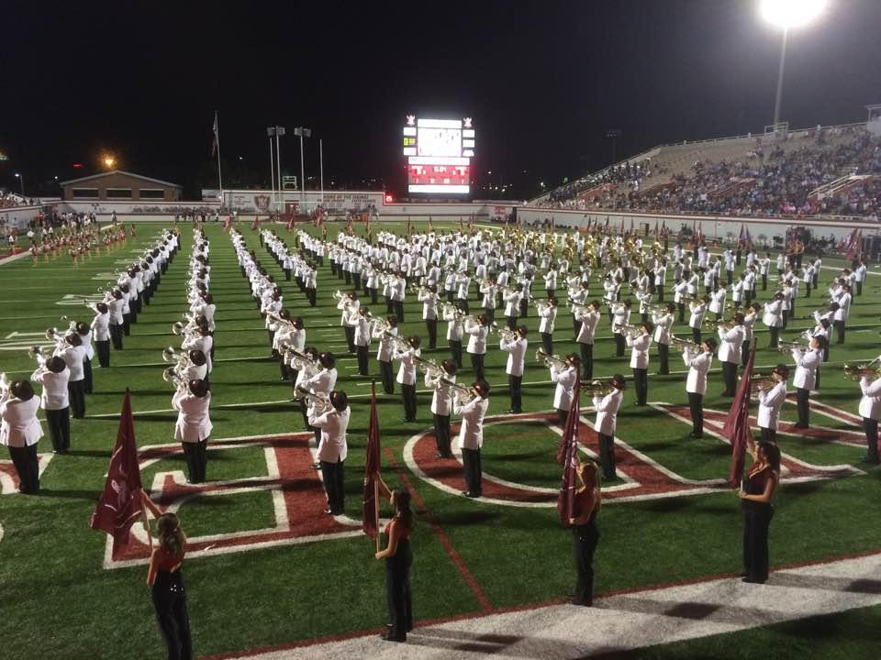
Georgia Bridgemen
Volunteer/Chaperone Opportunities

Slide 32
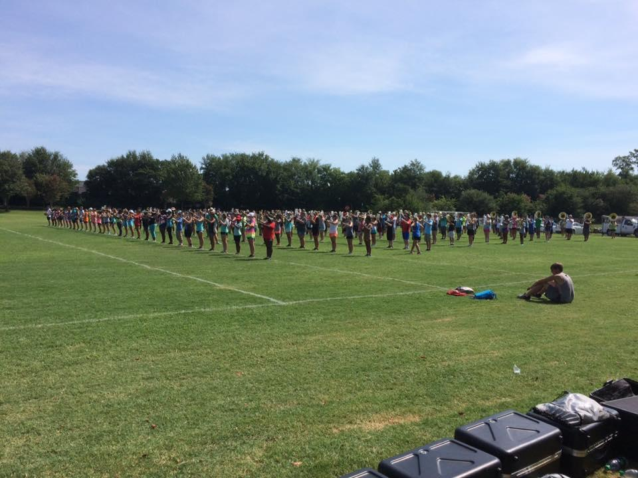
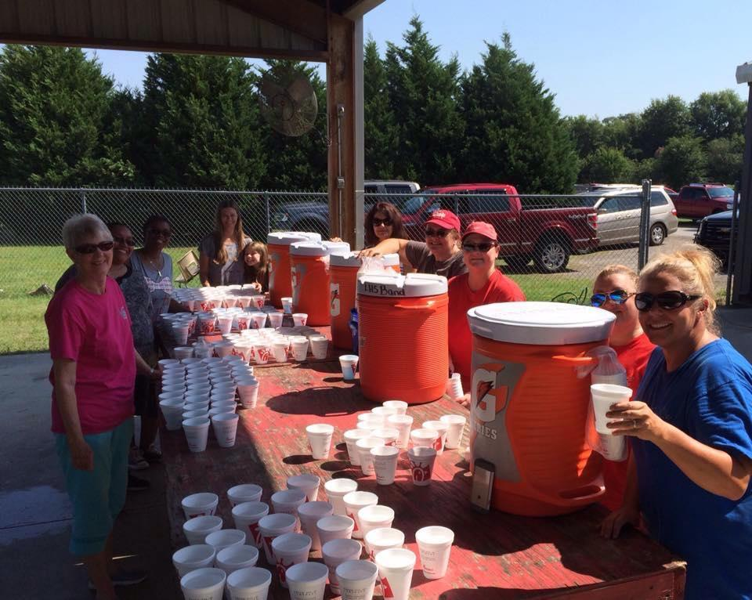
Band Camp
Band Camp is in July and lasts 2 weeks. During these 2 weeks, many volunteers are needed.
Water volunteers - mainly in the mornings from 9:00 - 12:00. Sometimes needed in the afternoons and evenings.
Chaperoning at the Mall during band camp - chaperones are needed to monitor the students at the Mall from 12:00 - 1:30.
Dinner Volunteers - volunteers are needed from 4:30 - 6:30 (setting up, serving, and cleaning up).

Slide 33
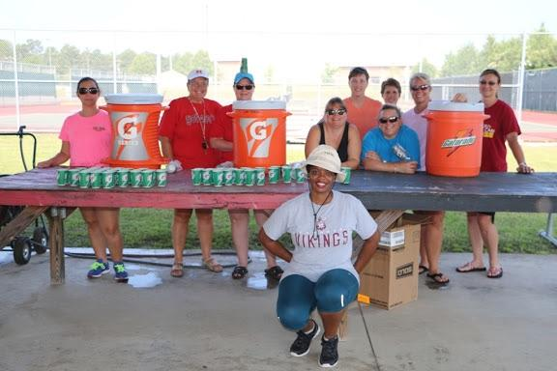
Water
Job Description: Filling water coolers with water and Gatorade throughout practices.
Band Camp - water volunteers are needed in the mornings from 9:00 - 12:00 and in the evenings from 6:00 - 9:00. Occasionally, we will need afternoon volunteers from 2:00 - 6:00.
After School Practices - water volunteers are needed for all of our after-school practices from 2:45 - 5:30/6:00. These practices are usually on Monday, Tuesday, Thursday.
Home Games - water volunteers are needed for all home games.

Slide 34
Prop and Pit Uniforms
Job Description: building/repairing props and other equipment, moving/unloading equipment and instruments, moving equipment and instruments before, after, and during the show
Job Description: measure all 8th graders for their uniforms, order uniforms, organize white jackets & hats, repair & wash white jackets, help the students get ready for all games & competitions, sanitize hats

Slide 35
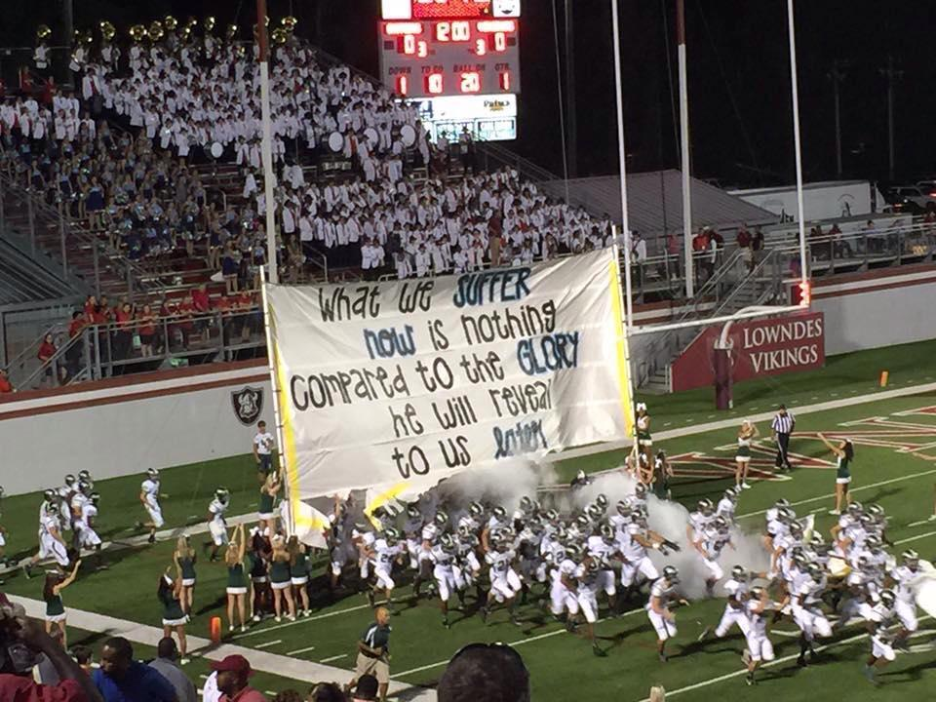
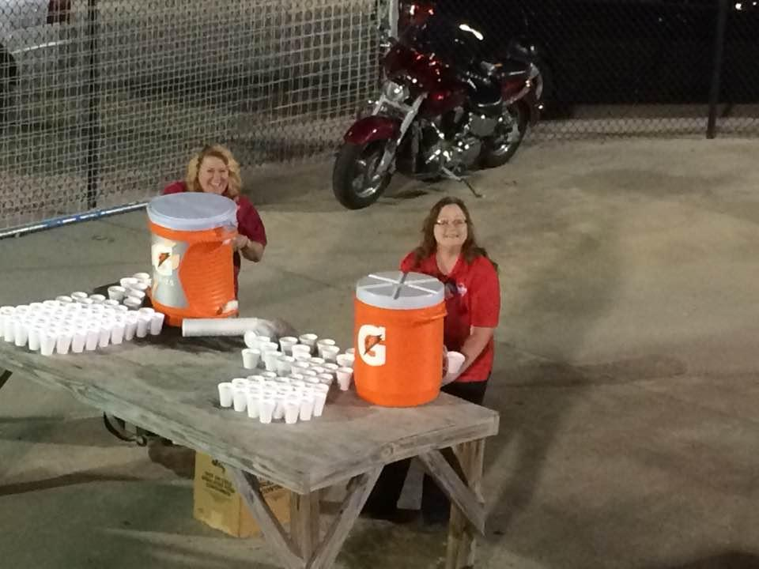
Home Game Chaperones/Volunteers
Chaperones/Volunteers are needed for ALL home games. All Chaperones/Volunteers MUST have a background check completed before chaperoning.
As a Home Game chaperone/volunteer, you will be in a rotation for the following:
Selling programs
Escorting the Bridgemen from the band room to the stands
Helping set-up water
Monitoring underneath the band stands
ALL Home Game chaperones should be willing to help in all assignments!

Slide 36
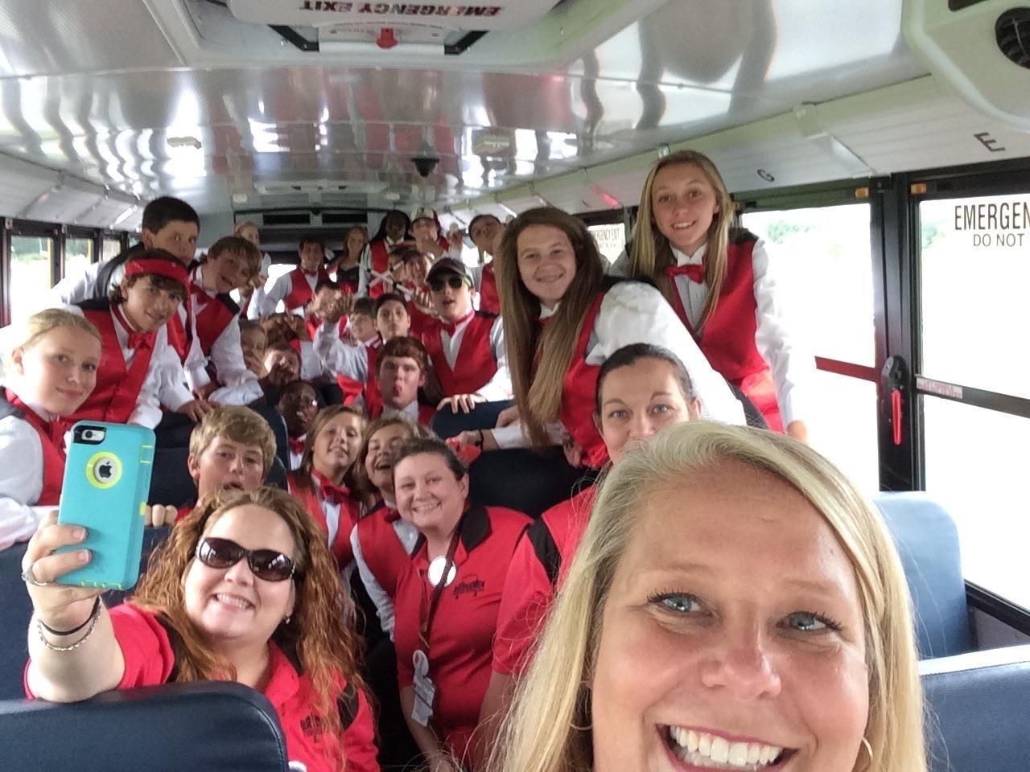
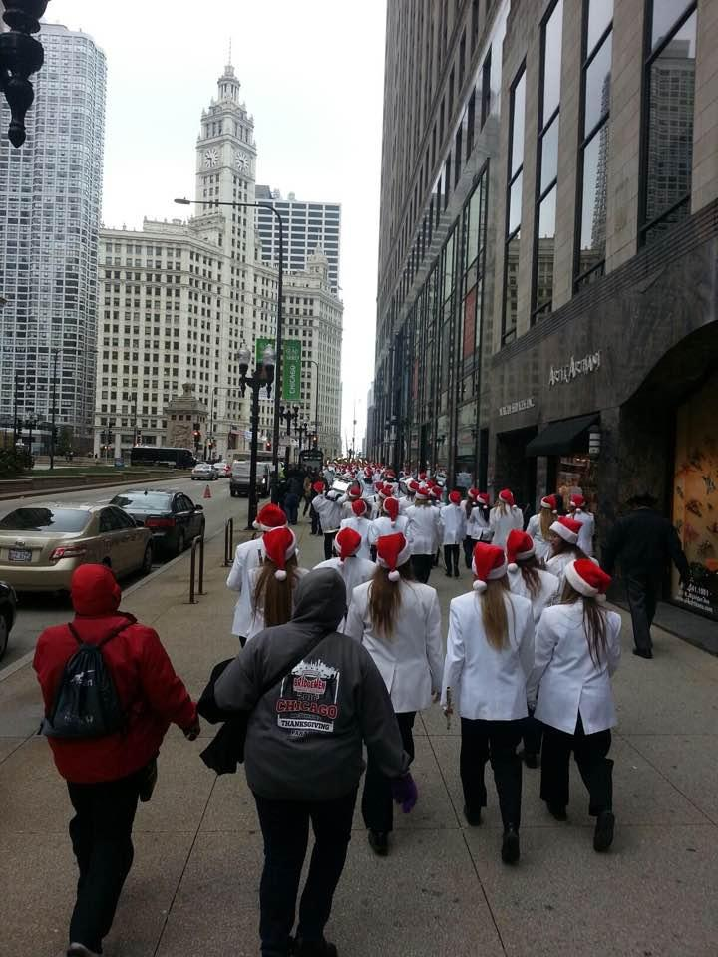
Travel Chaperones/Volunteers
Travel chaperones/volunteers are needed for all away games and competitions. All chaperone/volunteers MUST have a background check completed before chaperoning.
As a travel chaperone, you must be willing to help in any/all situations. If you see something that needs to be done, DO IT.

Slide 37
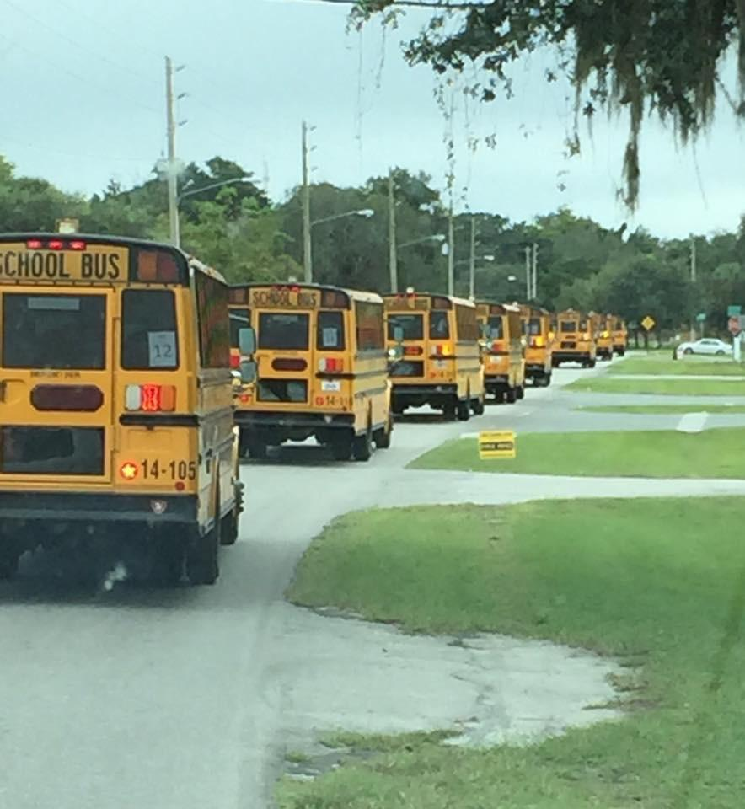
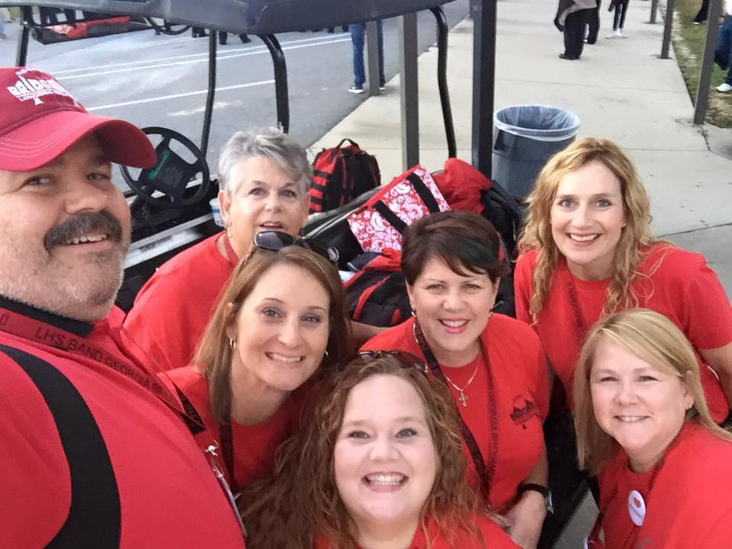
Nurses Bus Drivers
The Bridgemen also need nurses to volunteer their time. Nurses are needed during band camp, after-school practices, home games, and away games.
Bus drivers are needed for all away games and competitions. All bus drivers must possess or get a CDL, class B license with a school bus and passenger endorsement.

Slide 38
Fundraising for Your Student
Each Student has a personal account, statements emailed monthly:
Numerous ways to put money in your Student Account:
Birdies for the Bridgemen Golf Tournament – Bowman
GoFi App – Chris Buescher
Raffle Tickets for Trips – Chris Buescher
Football Program Ads – Chris Buescher

Slide 39
Fundraising for Your Student
Wild Adventures Fundraising Opportunity
The Wild Adventures Concert series for 2018 has been announced! These concerts allow our parents and older students (16 years old and above) the opportunity to earn valuable funds for band accounts. Many concerts are scheduled this year and workers are needed for food service, concert crew, and a host of other responsibilities! $7.50 per hour is credited to your band account.

Slide 40
Band Boosters-General Comments
Most everything associated with the Band Program you can learn about or have your question answered via the correct Booster members.
All items of student grades, discipline, and school related matters are to be answered by the Directors.
See the website for a listing of all Booster Officers, and Committee Chairs.
Get involved, you will be glad that you did. So will your student!

Slide 41

Lowndes High GA Bridgemen-Total Team Effort!
The success of this great program only happens when:
We have the best directors and staff available
We have committed and dedicated students
We have active and engaged parents
We have the support of the School System

